Slide 1

Our Rural Future National Rural Development Policy
Gareth Makim
Department of Rural and Community Development and the Gaeltacht

Slide 2
Our Rural Future 2021-2025
Represented an ambitious new approach to rural development in Ireland.
Whole-of-Government policy for rural Ireland for five years.
Focused on sustainable economic, social, and environmental development.
Key principles include:
Place-based policy-making
Participative approach
Policy alignment

Slide 3


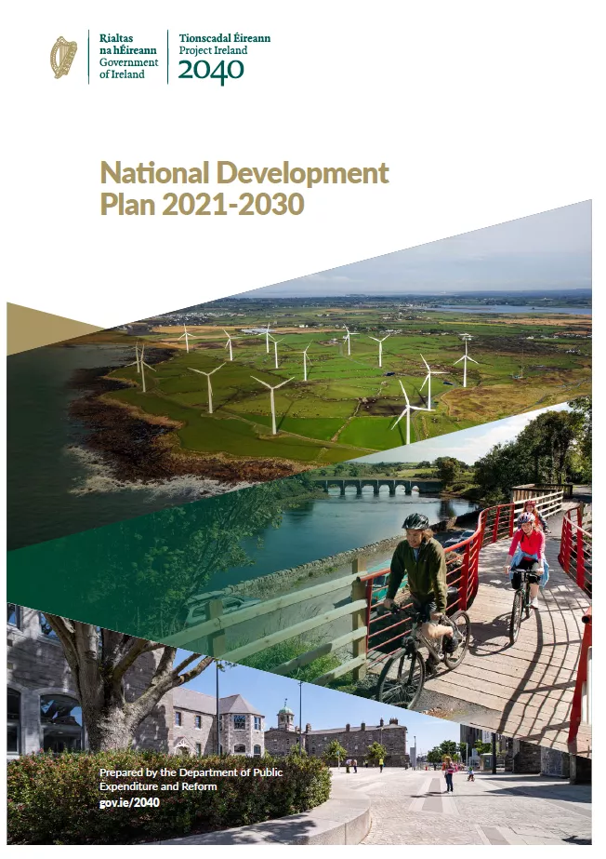

Policy Coherence
Supports delivery of other key Government policies
Directly supports achievement of UN’s Sustainable Development Goals

Slide 4
Delivery
More people living and working in rural Ireland
Investment in rural towns as hubs for commercial and social activity
Improved access to public services, such as public transport
Rural and regional enterprise supports
Major capital investments such as National Broadband Plan
New policy initiatives, such as Town Centre First and Connected Hubs

Slide 5
The next iteration of Our Rural Future…
PFG commitment – continue our whole-of-Government approach.
Build on the momentum of the first policy.
Policy development
Almost 2,000 people have given us their views so far
Upcoming public written consultation
Also informed by an OECD Review of Irish Rural Policy
Other stakeholder engagement

Slide 6
Main takeaways
Biggest successes of Our Rural Future 2021-2025:
More than 60% hailed the improvements to digital connectivity and remote working as the biggest positive change.
The development of community facilities and public transport services also recorded strong favourability, followed by outdoor amenities and town regeneration.
Major challenges remain for the new policy:
Demographic trends around ageing populations and youth retention were the No.1 concern, followed by housing, infrastructure, social isolation and resilience in responding to extreme weather events.

Slide 7
Infrastructure and Services
Rural communities prioritise investment in essential infrastructure, particularly housing, public transport, and healthcare facilities.
Key infrastructure supporting population growth, in areas such as energy, water and waste, roads and active travel also featured.
For public services, investment should focus on healthcare services, public transport services and social care and care for older people.
Other areas frequently listed included community resources, rural safety and youth services and supports.

Slide 8
Enterprise and Tourism
Key sectors identified for rural job creation include tourism, digital technology, agriculture and forestry, and renewable energy.
However, progress is hindered by significant barriers, such as housing shortages, poor infrastructure, and limited access to finance.
Despite significant tourism potential in rural Ireland, only 33% of participants believe this potential is being fully realised.
Participants recommended increased investment in cultural infrastructure and heritage conservation, improvements to existing attractions, and development of specialised local experiences.

Slide 9
Other key concerns
A majority (58%) of respondents perceived their neighbouring towns and villages as lacking vitality, citing need for housing, addressing vacancy and improved transport links.
Amongst environmental concerns, extreme weather events, biodiversity decline and management of water and waste featured most prominently.
94% said sustainable agriculture, marine and forestry sectors were Very important or Essential to rural areas, with a focus on consumer trust, sustainability and competitiveness.

Slide 10
Key Themes: Vibrant Rural Places
Putting in place the infrastructure and services needed to make rural places attractive and vibrant:
Housing and associated infrastructure
Improving transport connectivity
Digital infrastructure
Town and village regeneration
Community and recreational amenities
Access to services
Accessibility

Slide 11
Key Themes: A Strong and Diverse Rural Economy
Supporting rural enterprises to start and to grow:
Improving access to business supports and finance
Ensuring we can meet current and future skills needs
Realising the potential in rural tourism
Strengthen and protect future of agriculture
Opportunities in remote working and hubs

Slide 12
Key Themes: Resilient Rural Communities
Fostering socially inclusive and resilient communities:
Ensuring the sustainability of the Gaeltacht and islands
Developing capacity amongst community groups
Integrating minority or marginalised communities
Promoting and protecting our culture and heritage
Caring for our older people
Youth engagement, amenities and supports

Slide 13
Key Themes: A Greener Rural Future
Meeting the challenges and maximising the opportunities that come from climate adaptation:
Responding to extreme weather events
Building low-carbon, renewable energy capacity
Developing sustainable agriculture practices
Potential of the green, circular and bioeconomy
Protecting our natural heritage and biodiversity

Slide 14
Next Steps
Launch final public consultation – end October
Sets out the priorities and ambitions of the Policy
Work with Departments to develop actions
Government approval and publication – 2026

