Slide 1
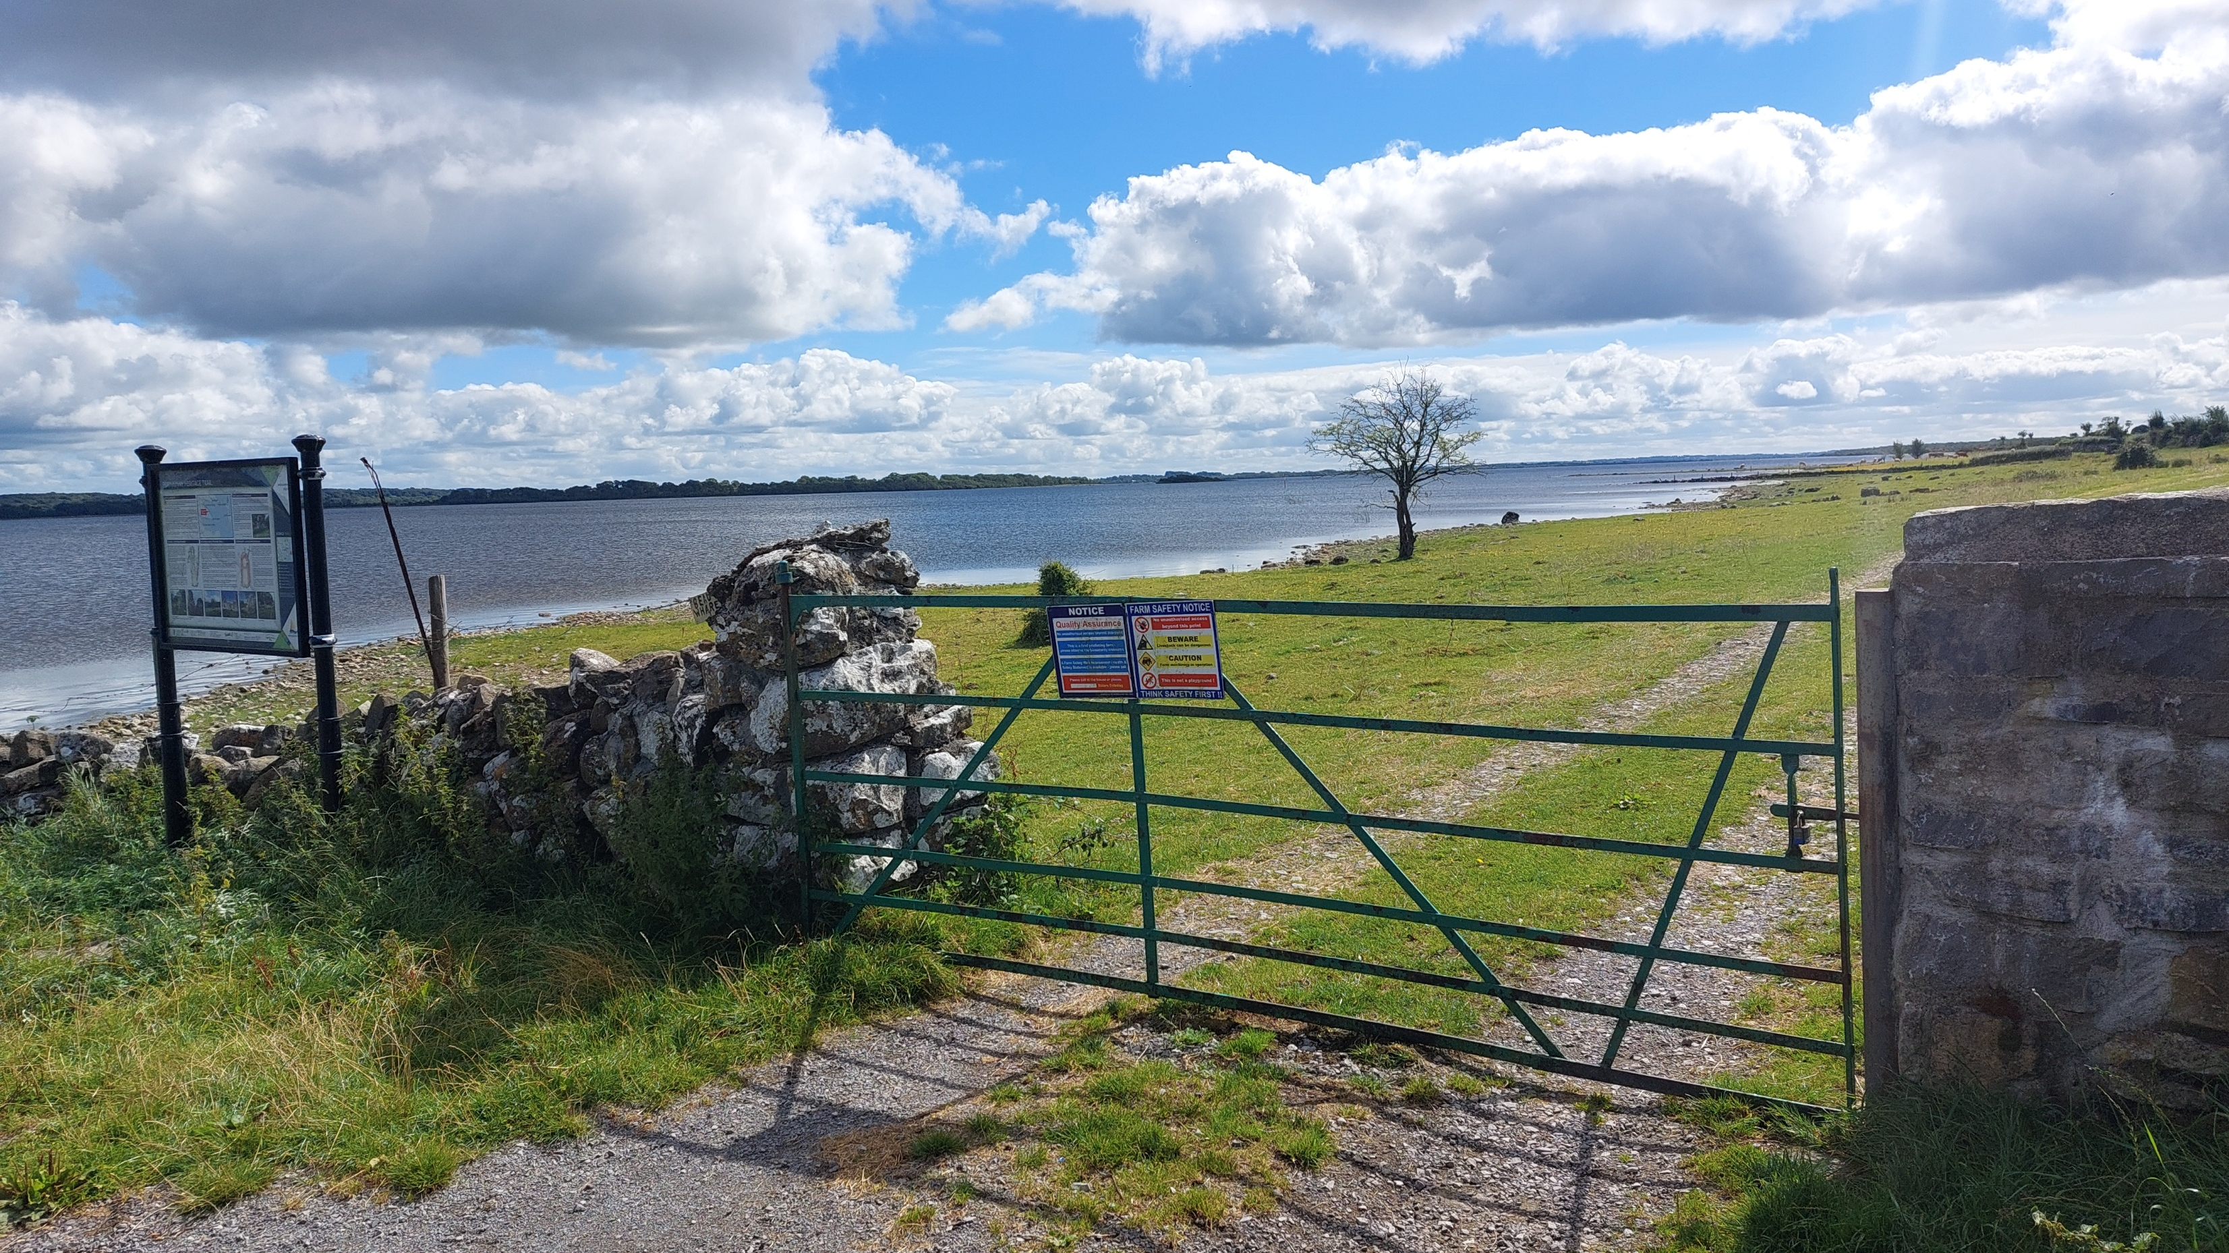
Bridging the Gap: Local Rural Futures in the Context of National and European Strategies
Smart Towns & Villages Conference 2025 ‘Reimagining Rural Ireland’
Associate Professor Karen Keaveney
Citizen Rural Research Lab
UCD School of Agriculture & Food Science
https://www.ucd.ie/citizenrural/
Photo: KKeaveney, Portrunny, Roscommon, IRL

Slide 2
Today … setting the context … A Call to Action
Linking European policy with the local level & consider future changes
Where we are now – Longterm Vision for Rural Areas
What is proposed – EU Rural Action Plan & Post-2027 MFF
Rural Europe: A better deal?
Promise Vs Risk

Slide 3
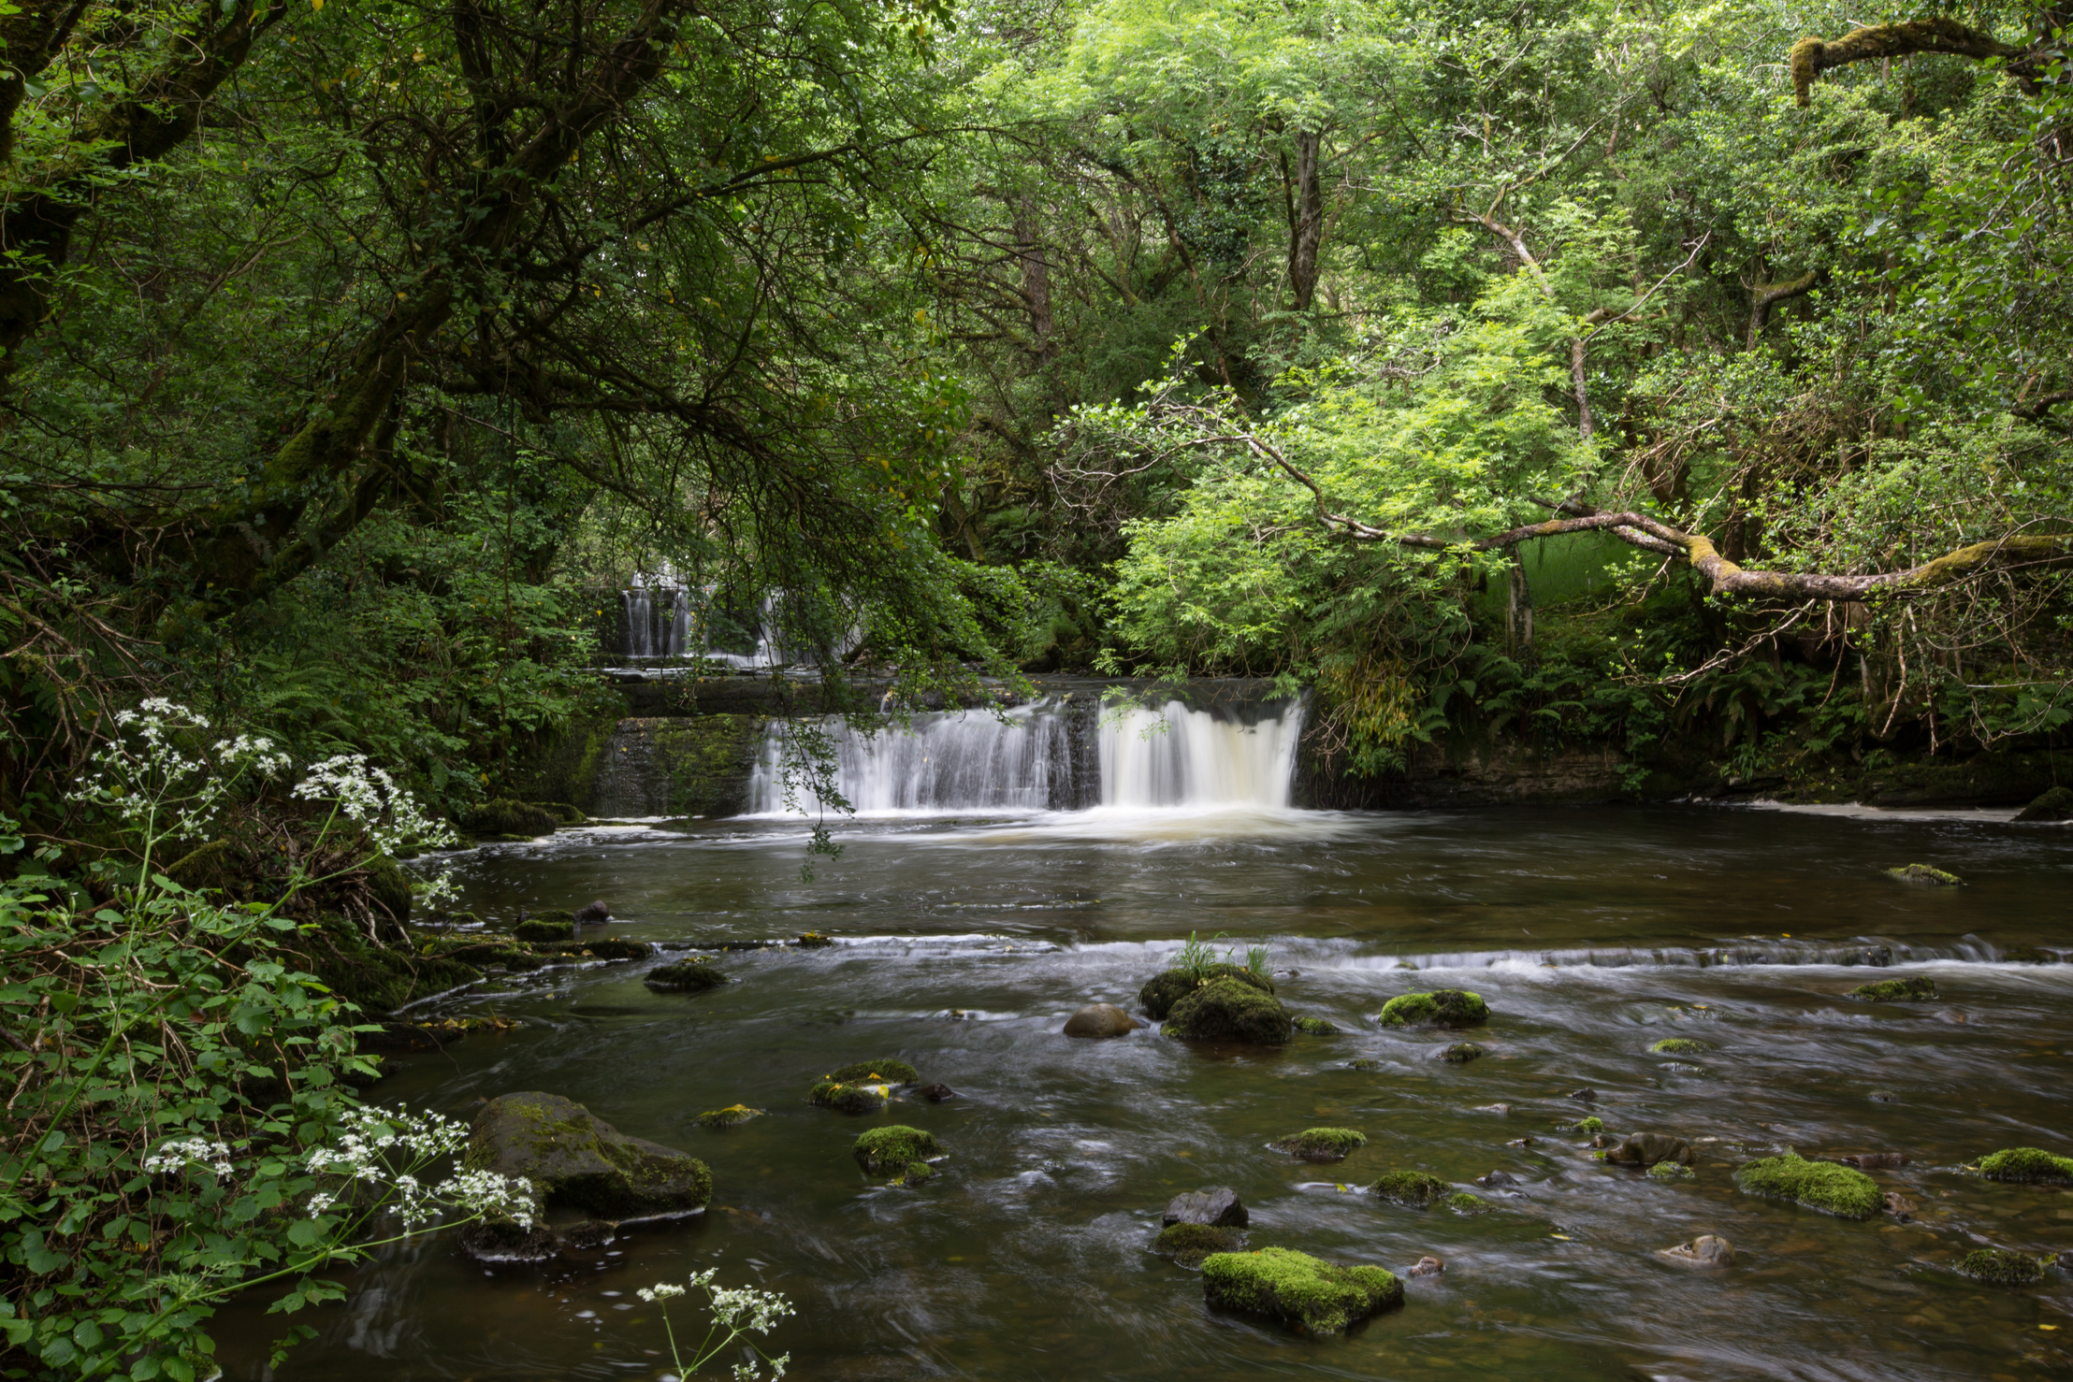
Where are we now?
Photo: Fowley's Falls, Co. Leitrim, IRL. HelenL100, Getty Images

Slide 4

The long-term vision for EU’s rural areas

Slide 5



The long-term vision for EU’s rural areas - Towards stronger, connected, resilient and prosperous rural areas by 2040
The start of the rural vision 2040
European Commission Communication
A long-term Vision for the EU's Rural Areas - Towards stronger, connected, resilient and prosperous rural areas by 2040 (June 2021)
European Commission 2019-2024 term
Involved Commissioners
Dubravka Šuica, EC Vice-president, Demography & Democracy
Janusz Wojciechowski, Agriculture
Elisa Ferreira, Cohesion and reforms
https://eur-lex.europa.eu/legal-content/EN/TXT/?uri=CELEX%3A52021DC0345
Notes:
The EU launched a reflection with all actors across Europe to draw the common ambitions to achieve for rural areas. This process was coordinated by three Commissioners of the 2019-2024 term of office: the Vice-President Šuica (Democracy and demography), with Commissioners Wojciechowski (Agriculture) and Ferreira (Cohesion and reforms) as lead and co-lead.
The process resulted in the publication of the European Commission Communication on the long-term vision for EU's rural areas in 2021, https://eur-lex.europa.eu/legal-content/EN/TXT/?uri=CELEX%3A52021DC0345 .
Since the adoption, there has been constructive dialogue with EU institutions and bodies.
The Communication triggered political reactions from the Council of the EU, the European Parliament, the Committee of the Regions, the Economic and Social Committee who reacted positively to the Communication.

Slide 6
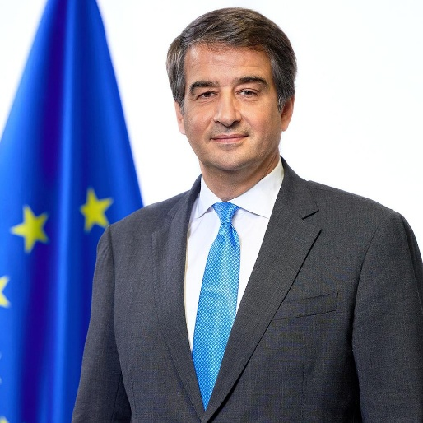
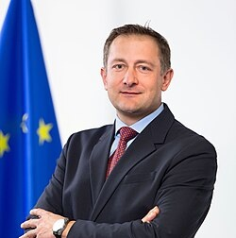

The long-term vision for EU’s rural areas - Towards stronger, connected, resilient and prosperous rural areas by 2040
The rural vision now
European Commission 2024-2029 term
Executive Vice-President Cohesion & reforms
Raffaele Fitto
Commissioner
Agriculture & Food
Christophe Hansen
European Commission Communication: A long-term Vision for the EU's Rural Areas - Towards stronger, connected, resilient and prosperous rural areas by 2040 (June 2021)
Notes:
For the 2024-2029 term of the European Commission’s college of Commissioners, the long-term vision for EU’s rural areas falls under the portfolio of two Commissioners:
Raffaele Fitto: Executive Vice-President for Cohesion and Reforms
Christophe Hansen: Commissioner for Agriculture and Food

Slide 7


A new vision for agriculture and food, support for rural areas (Feb 2025)
Working in synergies with the rural vision 2040
Four priority areas
Actions for vibrant and well-connected rural areas
Enhance synergies and complementarities
EU Rural Action Plan update in 2025
Strengthen the Rural Pact
Further operationalise the rural proofing principle
Strengthen participatory, local development tools, such as LEADER/CLLD and Smart Villages
Further develop the concept of functional rural areas
Address the targeted spread of disinformation in rural areas
Attractive agri-food sector
Competitive and resilient sector
Future-proof sector
Vibrant & well-connected rural areas
Commissioner
Agriculture & Food
Christophe Hansen
https://agriculture.ec.europa.eu/overview-vision-agriculture-food/vision-agriculture-and-food_en
Notes:
A new Vision for Agriculture and Food was adopted by the European Commission in February 2025. This vision complements the long-term vision for EU’s rural areas (launched in 2021) by setting out specific actions for vibrant and well-connected rural areas.
The vision represents a roadmap for the future of farming and food in the European Union.
(For more detail on the Vision for Agriculture and Food, see slides 37-38.)

Slide 8
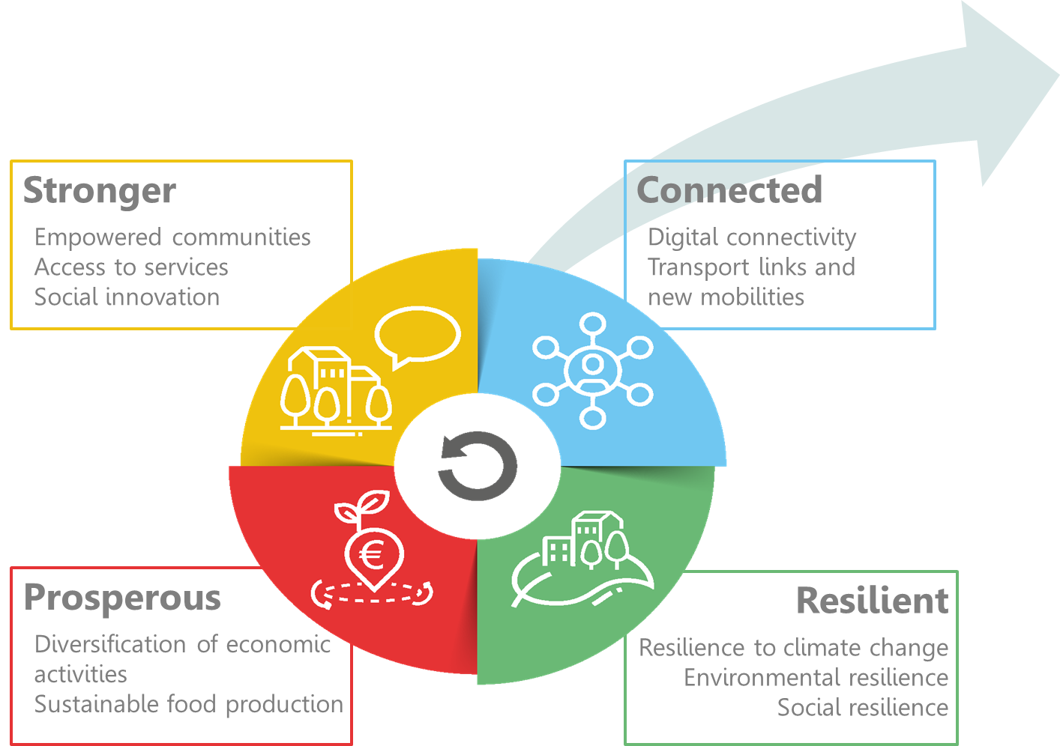

The long-term vision for the EU’s rural areas
Shared goals for 2040
Rural action plan (EC)
&
Rural Pact (everyone)
Notes:
Meanwhile, the EU rural vision 2040 continues to support rural regions through:
The rural action plan – actions that the European Commission has been implementing since 2021 (see slide 11); an update of the plan is expected by the end of 2025.
The Rural Pact – a stakeholder collaboration (see slides 16 to 22).
The European Commission’s rural vision prepares the ground for future action, but does not bring new funds. For now, stakeholders have to use existing policies and funds, as they have been agreed by the European Parliament and Member States in the Council, before the adoption of the rural vision.
The rural vision brought together the common aspirations of Europeans on how they would like rural areas to be in the future: stronger, connected, resilient and prosperous.

Slide 9
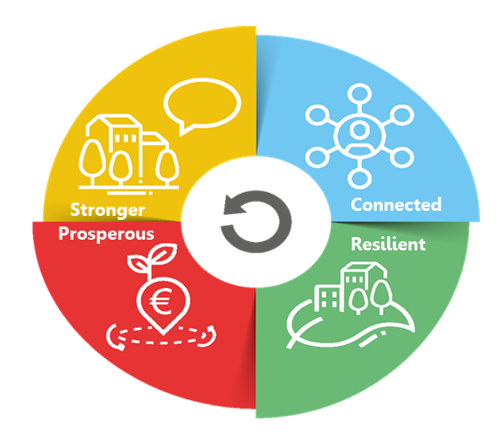
The rural action plan
10 SHARED GOALS FOR 2040
Attractive spaces, developed in harmonious territorial development
Engaged in multi-level and place-based governance
Providers of food security, economic opportunities, goods and services for wider society
Dynamic communities focusing on well-being
Inclusive communities
Flourishing sources of nature
Fully benefiting from digital innovation
Entrepreneurial, innovative and skilled people
Lively places equipped with efficient, accessible and affordable public and private services
Places of diversity
Notes:
The rural vision set 10 shared goals to be achieved by 2040 and cover a wide variety of thematic areas.
The vision examplifies the need to think strategically about rural areas in an integrated way to be able to respond to the needs and opportunities of rural areas.
The vision aims to address the ambitions, needs and demands from all citizens. It includes farmers and their families, other businesses and people working in rural areas (many not involved in the agri-food and forestry sectors), as well as cities and towns that find mutual benefits with rural areas.
To achieve all the goals of the vision, it is absolutely necessary to broaden the range of stakeholders involved in rural development, including public authorities and policy makers, civil society involvement, academia, citizens and businesses.

Slide 10
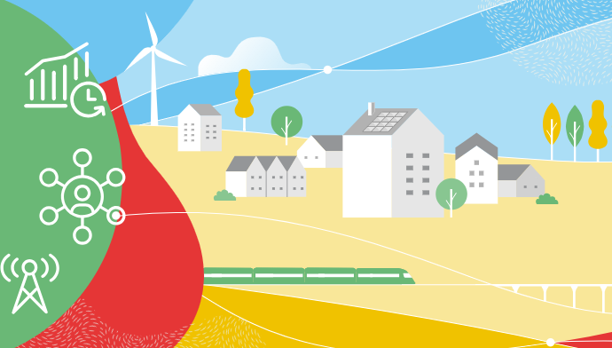
The rural action plan: horizontal actions
EU RURAL ACTION PLAN
6 Horizontal actions
The EU Rural Observatory (more)
Improved Statistics on rural areas
Functional Rural Areas
Rural Proofing at EU level
Rural toolkit on EU funding (more)
Rural Pact
Notes:
Similarly, all Horizontal actions are also launched.
1. (First action: the EU Rural Observatory)
First, the Rural Observatory which is coordinated by the Joint Research Centre (JRC) of the European Commission. It was born with one clear ambition: give everyone access to essential data about rural areas to foster a better understanding of their circumstances and diversities, hence increasing the analytical capacities for evidence-based policies. A hundred indicators from multiple sources are included, covering economic, social and environmental dimensions at different levels of granularity. Please, browse through it if you have not done so yet.
Website: https://observatory.rural-vision.europa.eu/?lng=en&ctx=RUROBS
2. (Second action: Statistics on rural areas)
Before making them accessible in a centralised platform, data needs to be collected. To understand the complexity of the issues at stake more and better-quality data on rural areas are needed. This is why the European Commission has launched a second action, working with the statistics departments of Member States on improving statistics on rural areas. A new regulation is being discussed on population statistics, and experimental datasets on healthcare and education facilities have been published. All this to make the Rural Observatory even more comprehensive.
3. (Third action: definition of functional rural areas)
A third action is the application of the Functional Areas concept to the rural environment. Functional Areas seek to go beyond administrative boundaries through a better understanding of population and service flows, among other things. A first methodology of Functional Rural Areas has already been prepared by the Commission’s Joint Research Centre and DG REGIO. Meanwhile, the Commission, and the World Bank are working on a pilot project on Functional Areas, combining cities, towns and suburbs as well as rural areas. Indeed, the rural-urban space is understood as an interlinked continuum.
4. (Fourth action: rural proofing at EU level)
The European Commission are promoting the mainstreaming of rural areas concerns and issues — hence our fourth action, rural proofing. It is about taking a rural lens to new policy making. In November 2021, the European Commission updated the guidelines that all Commission services use to build new initiatives. Services are encouraged to explore whether initiatives will have differential impacts on territories, and if so, ensure mitigation measures. For legislatives initiatives, Territorial Impact Assessment is the procedure in place. The European Commission has also run a thematic group on rural proofing at national and regional levels, so to get to rural-proof national legislation too.
5. (Fifth action: toolkit on EU funding)
The European Commission has developed a toolkit oriented to practitioners on how to make full use and combine the various EU funds to support rural projects, beyond CAP and Cohesion Policy. The toolkit has been launched on 6 February 2024, after having been discussed in stakeholder events in June and October 2023, with the support of the JRC.
Attached to the toolkit are various tools such as STRAT-BOARD, or the Handbook on territorial development strategies, also prepared by the Joint Research Centre with a focus on Cohesion Policy.
6. (Sixth action: Rural Pact): To propose and facilitate the Rural Pact, which we detail in the next slides.

Slide 11



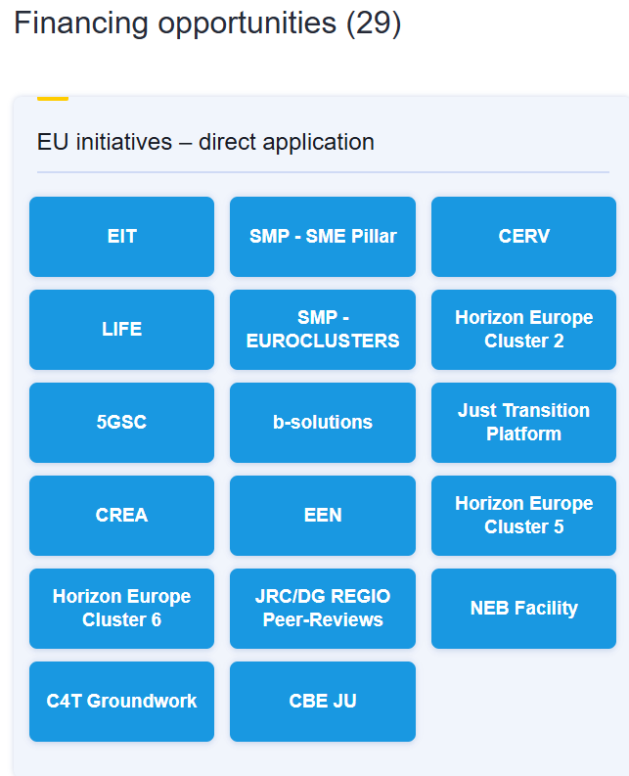
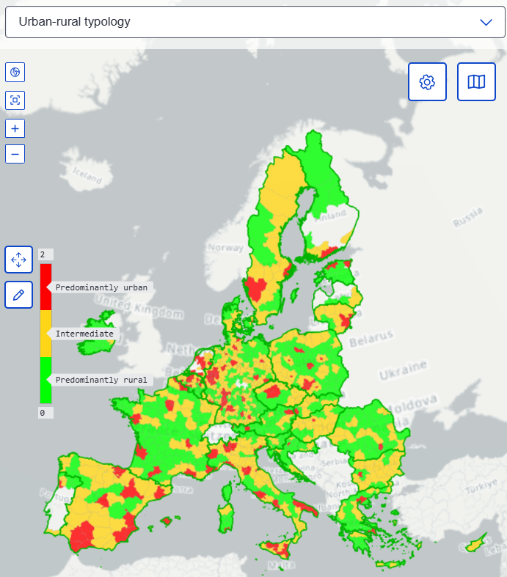
The rural action plan: horizontal actions
EU Rural Observatory
Rural Toolkit on EU funding
Offers relevant statistics, indicators and analyses
Supports knowledge production - important source of information for rural proofing
Comprehensive guide to EU funding and support opportunities for rural areas
Intended for local authorities, institutions and stakeholders, businesses and individuals
Collects existing EU funds, programmes and other support initiatives
Features practical examples and case studies, as well as practical guidance and knowledge
Improves collection and dissemination of data related to EU rural areas - provides evidence for policymaking
The data covers economic, social and environmental dimensions
https://observatory.rural-vision.europa.eu/?lng=en&ctx=RUROBS
https://funding.rural-vision.europa.eu/?lng=en
Notes:
The Rural Observatory is coordinated by the Joint Research Centre (JRC) of the European Commission.
It was born with one clear ambition: give everyone access to essential data about rural areas to foster a better understanding of their circumstances and diversities, hence increasing the analytical capacities for evidence-based policies.
A hundred indicators from multiple sources are included, covering economic, social and environmental dimensions at different levels of granularity.
Website: https://observatory.rural-vision.europa.eu/?lng=en&ctx=RUROBS
The Rural toolkit on EU funding was launched on 6 February 2024 by the European Commission’s Joint Research Centre (JRC) to support practitioners with making use of and combining the various EU funds for rural areas, beyond the CAP and Cohesion Policy.
Website: https://funding.rural-vision.europa.eu/?lng=en

Slide 12
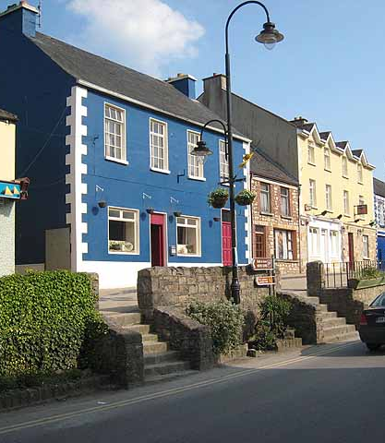
What next?
Photo: Oliver Dixon / High Street, Drumshanbo, Co. Leitrim, IRL.

Slide 13
Key Next Steps
early 2026
EU Rural Action Plan – review and update in early 2026
Post- 2027
Multi-Annual Financial Framework (MFF)

Slide 14
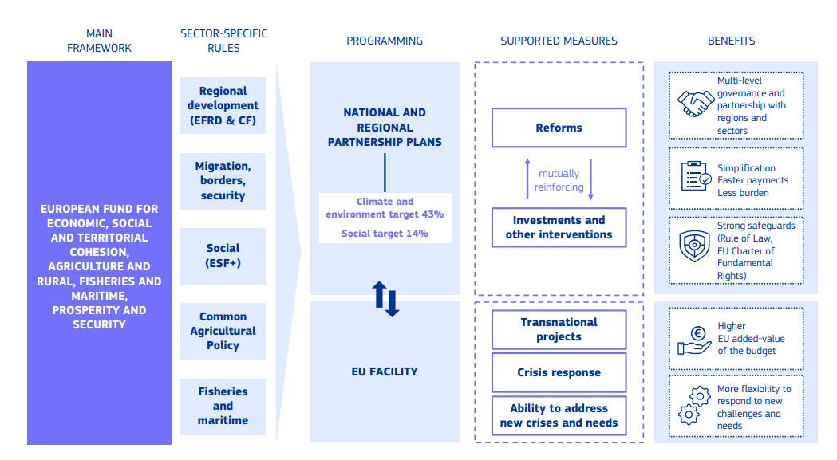
European Funding – Multiannual – Financial Framework – Post-2027
https://commission.europa.eu/document/download/3fb8dd83-268e-4e18-b446-cf8963719e0b_en?filename=MFF_National_Regional_Partnership_30.07_12h.pdf

Slide 15
EU Budget
Single National Plan
Local Projects
Allocation of long-term budget
Member stateds create one integrated plan
Funds are directed to targeted regional / local projects.
European Funding – Multiannual – Financial Framework – Post-2027

Slide 16
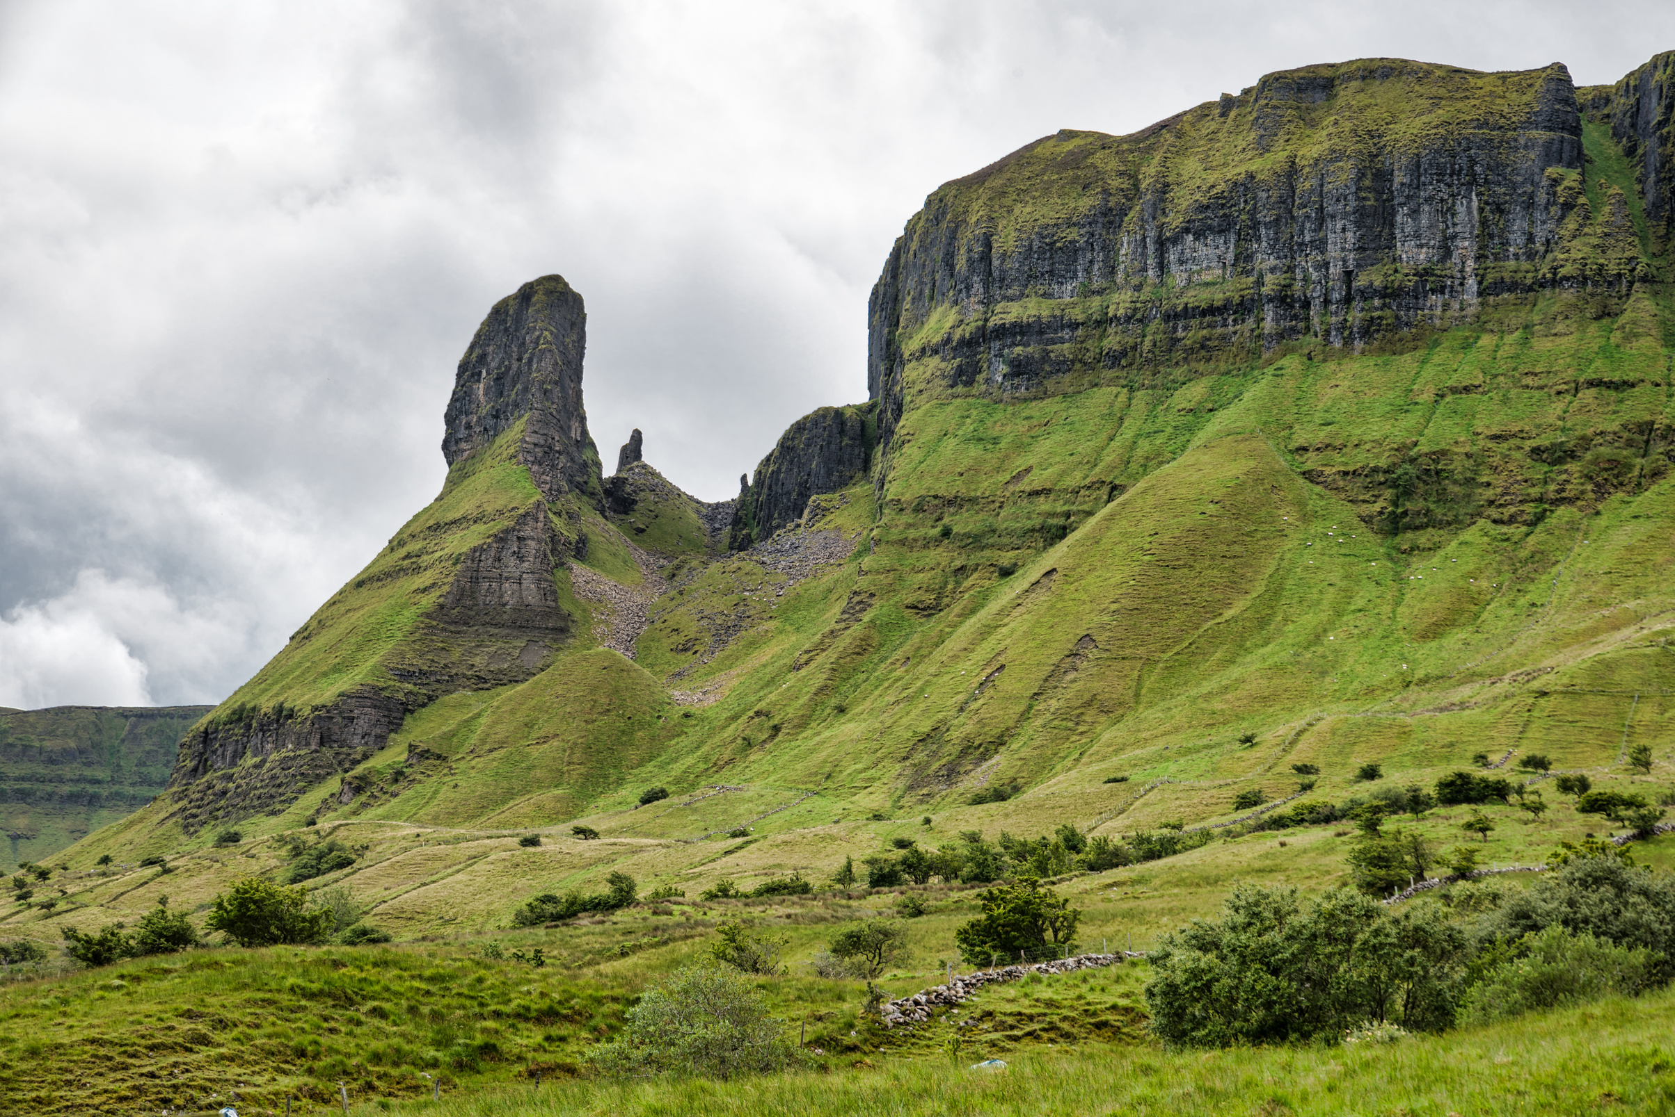
Rural Europe. A better deal?
Photo: Eagles Rock Leitrim, Co. Leitrim, IRL. Shawn Williams, Getty Images

Slide 17
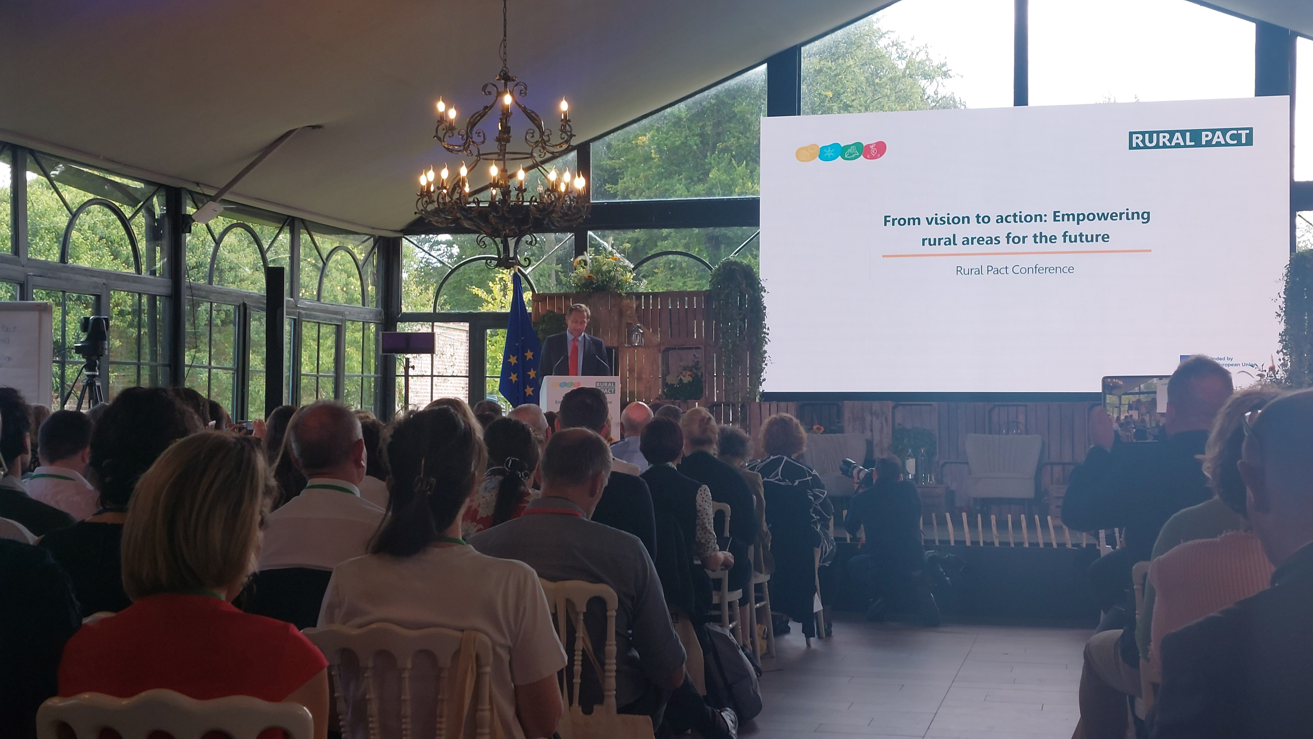
“Plans present opportunities for broader, more integrated support for rural areas … how synergies happen”
Commissioner
Agriculture & Food
Christophe Hansen
Opening Speech, to the Rural Pact Conference, Belgium September 16th 2025

Slide 18
Promises to Rural Areas
Current CAP instruments will be retained.
1
LEADER will be mandatory.
2
Plans must reduce territorial disparities.
3
Rural stakeholders must be engaged in design.
4

Slide 19
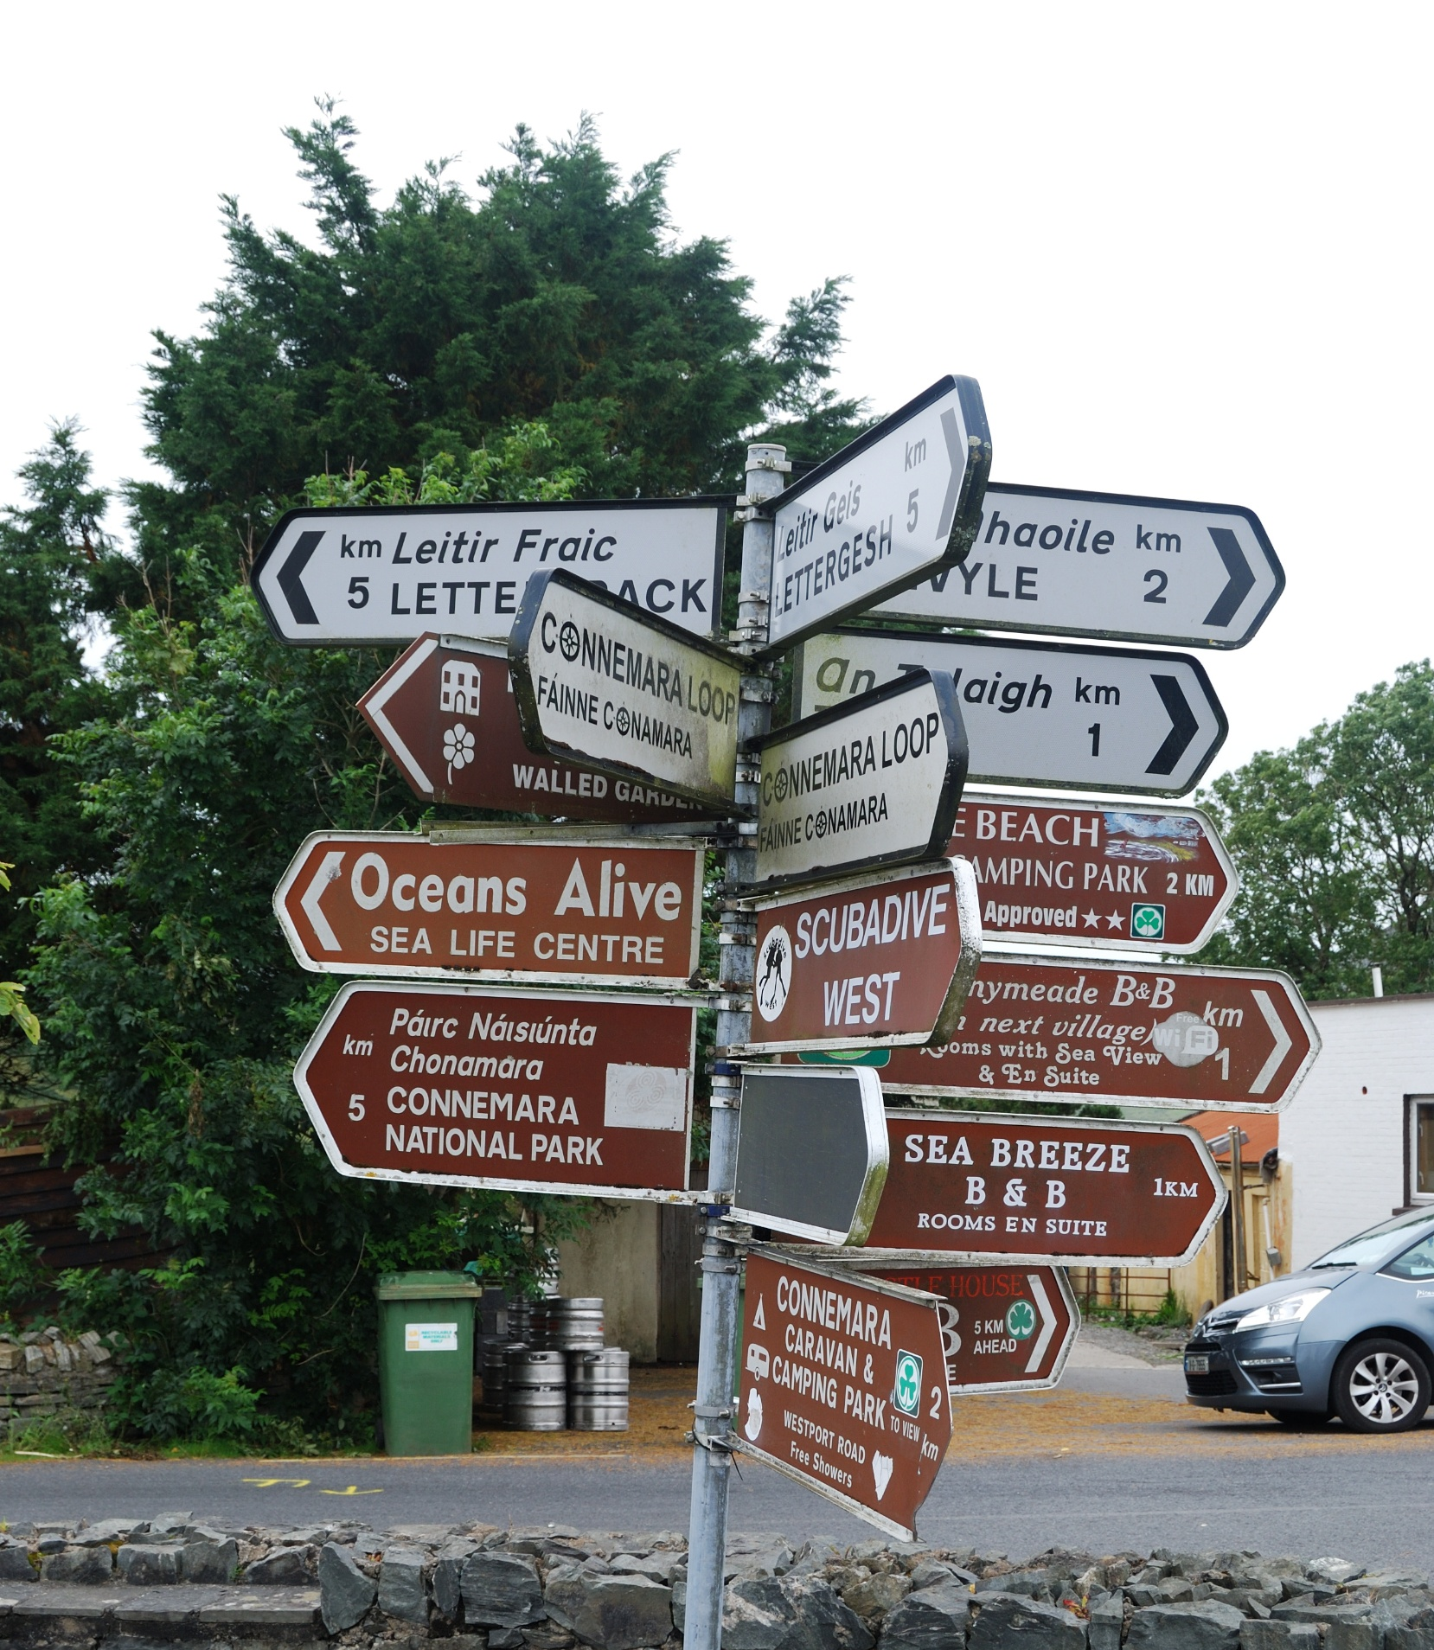
Promise Vs Risk
Local Perspectives
Photo: KKeaveney, Tully Cross, Galway, IRL

Slide 20
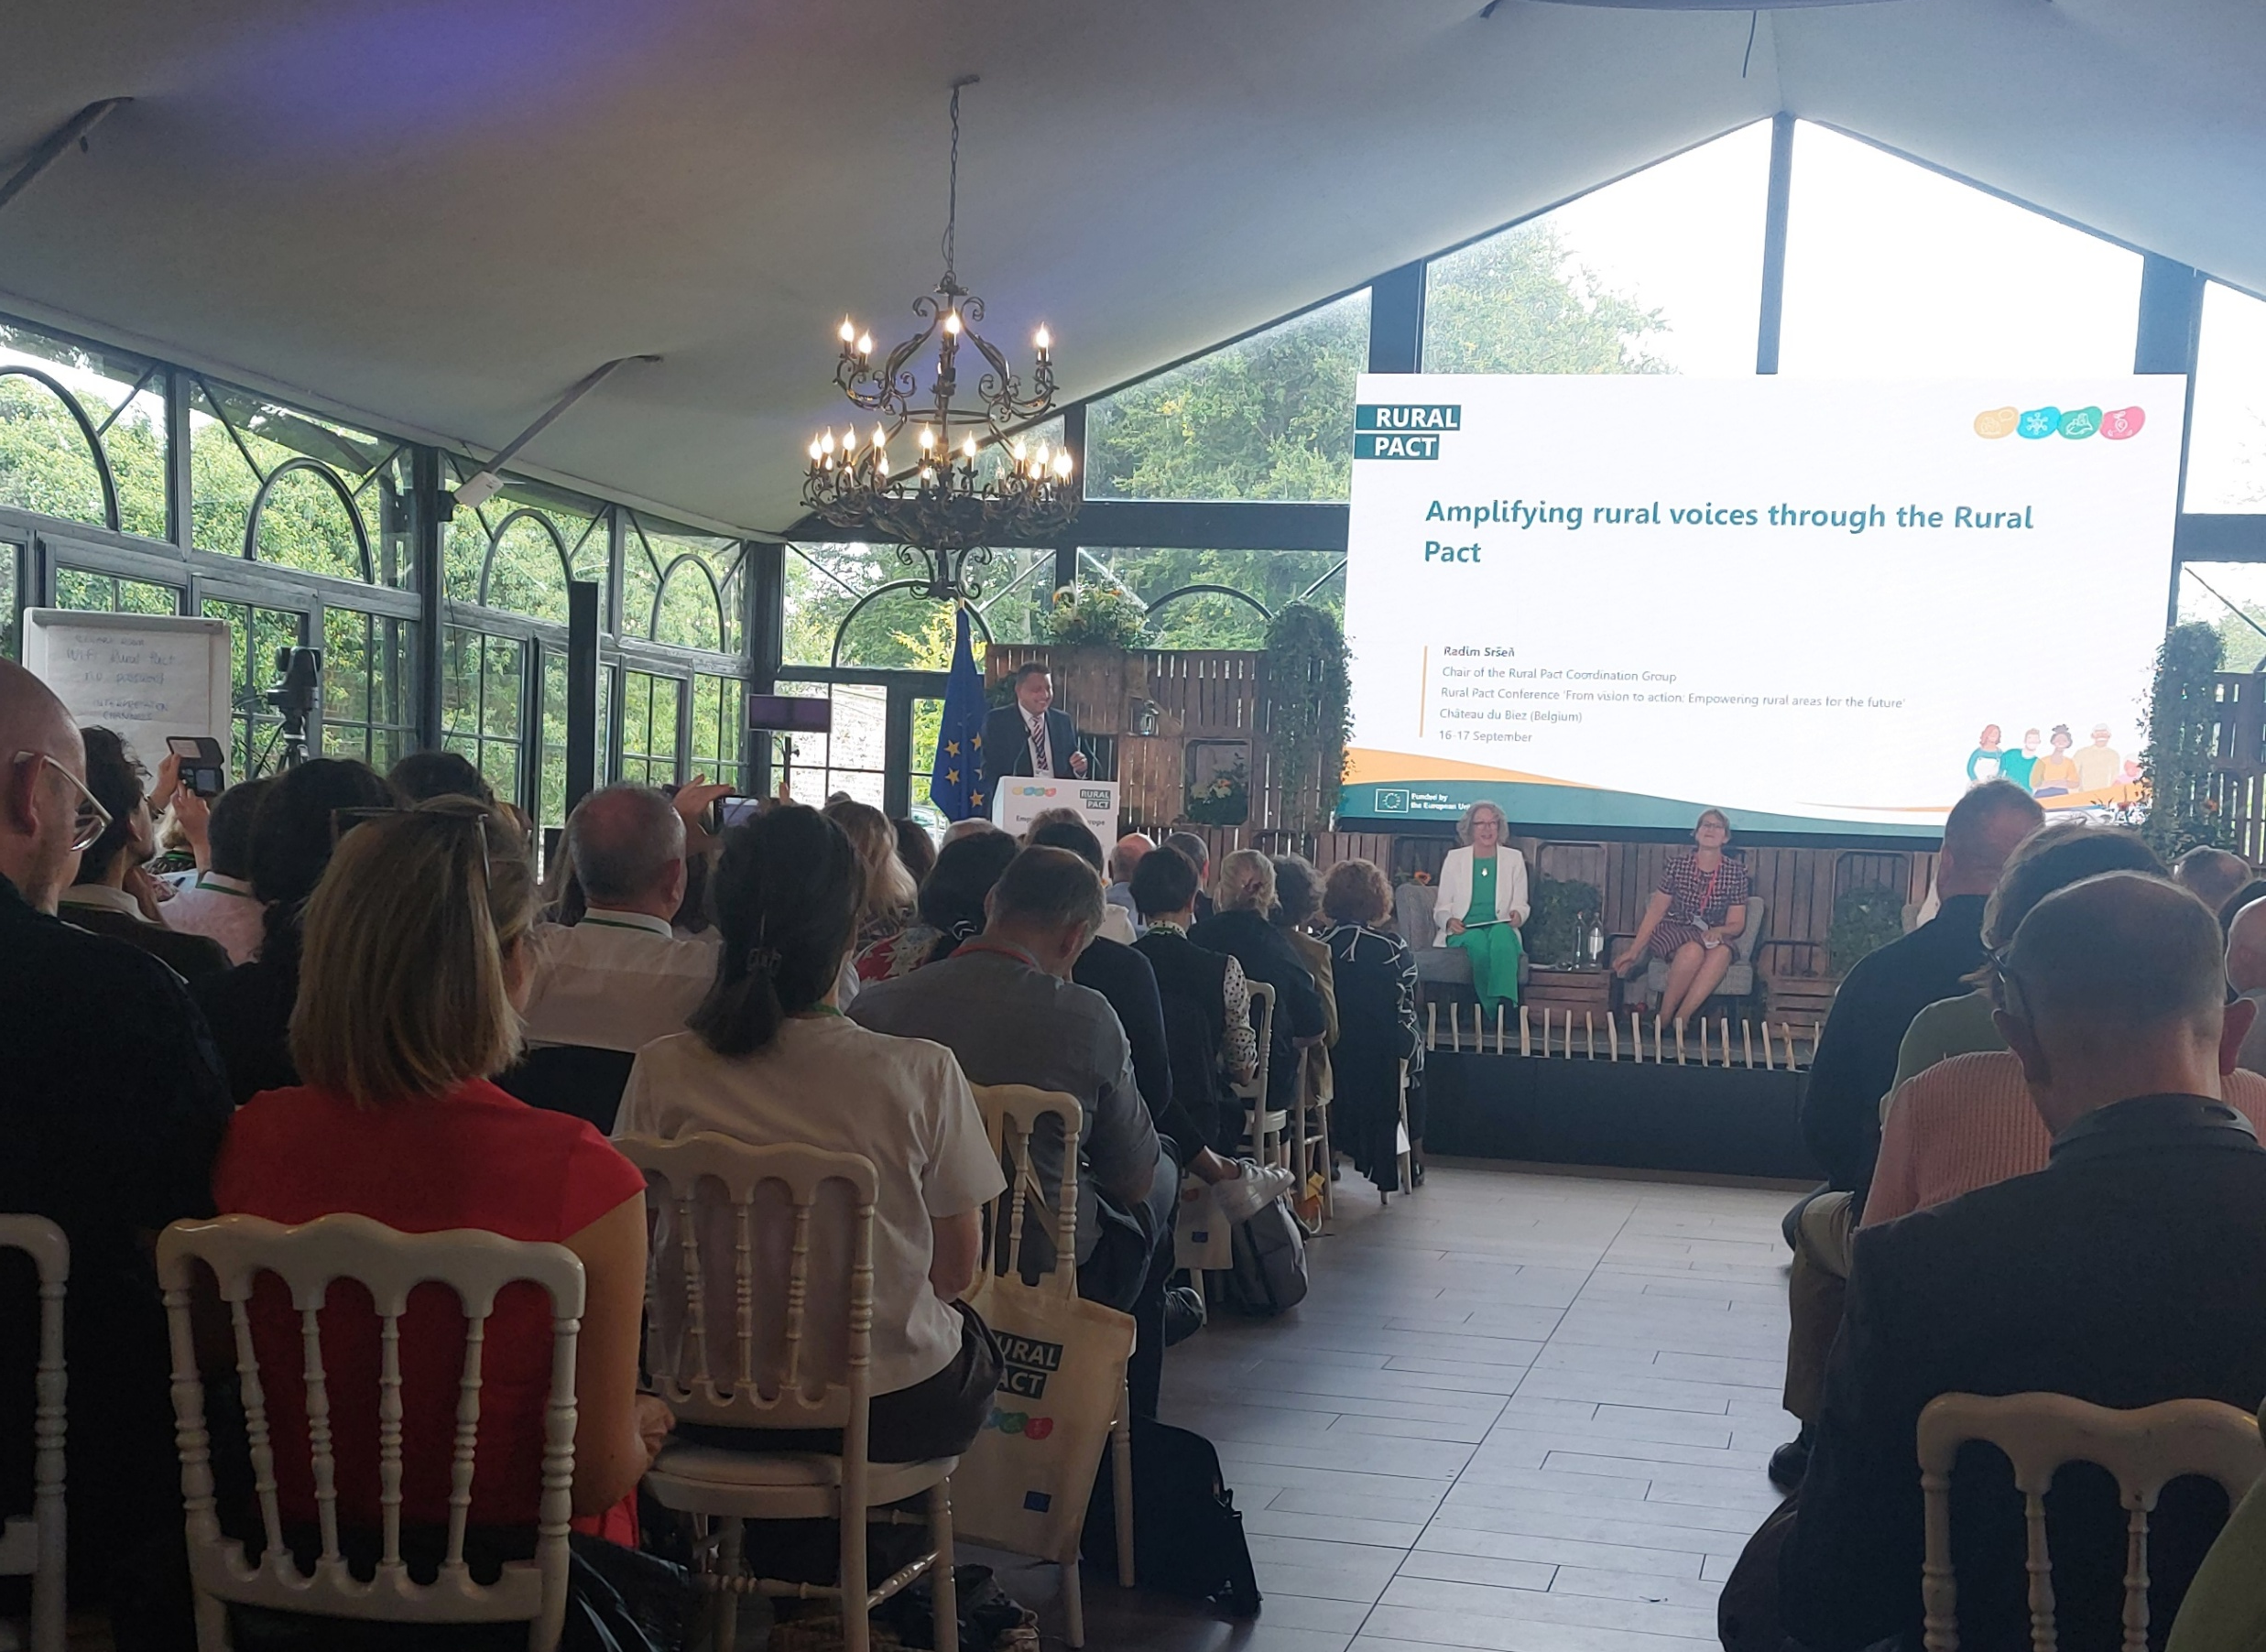
“I have to stress this … I actually fear that LEADER is not secure”
Panellist at the Rural Pact Conference, Belgium September 16th 2025

Slide 21
Goal: Flexibility & a simple, integrated approach for tailored local support
Concern: No ring-fenced funds and too much flexibility risk community led-local development

Slide 22
Negotiation Timeline
July 2025
Commission presented its official proposal
2025–2027
Negotiations between Member States & the European Parliament
Mid-2027
Target date for a final agreement to be adopted

Slide 23
“… don’t underestimate you … I think it’s really very important to get engaged in the detail”
Panellist at the Rural Pact Conference, Belgium September 16th 2025

Slide 24
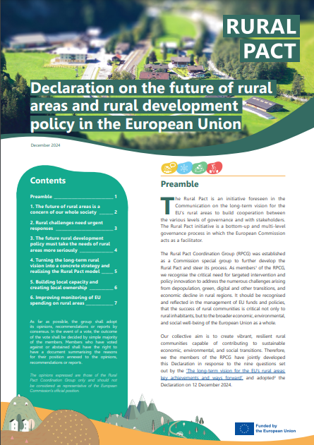





Declaration on the future of rural areas and rural development policy in the EU Rural Pact Coordination Group (Dec 2024)
Strategic proposal for the post-2027 rural policy framework
Collective response to the questions in the EC report on ‘the EU rural vision: key achievements and ways forward’
Available in 24 EU languages
Asserts the importance of EU rural areas for the whole society
Specifies the conditions to put in place for the recommendations to work
Calls for strengthening governance structures and capacities
Acknowledges key challenges and opportunities for targeted responses
Calls for specific policy responses to challenges and opportunities in rural areas
https://ruralpact.rural-vision.europa.eu/publications/rural-pact-coordination-group-rpcg-declaration-future-rural-areas-and-rural_en
Notes:
The Declaration, adopted by the Rural Pact Coordination Group (RPCG) on 12 December 2024, sets out a strategic proposal for the post-2027 EU funds and policies to address the challenges faced by rural areas.
The Declaration calls for a strong shift in future policies to ensure the sustainability and resilience of EU’s rural areas in the long run, suggesting:
Increased and streamlined funding for rural areas through a compulsory minimum allocation to rural areas from all post-2027 EU funds and a better resourcing of community-led, place-based approaches, such as LEADER and Smart Villages;
Enhanced coordination among relevant administrative bodies at all governance levels, compulsory implementation of the Rural Pact model, including multi-fund and multi-stakeholder coordination, and guidance and training for the implementation of ‘rural proofing’;
Capacity building for local actors, including on access to funding, tailored interventions reflecting the diversity of rural areas and their particular needs, and extended use of data to inform evidence- and result-based future policies.
The Declaration was developed through a strong participatory process involving RPCG members.
https://ruralpact.rural-vision.europa.eu/publications/rural-pact-coordination-group-rpcg-declaration-future-rural-areas-and-rural_en

Slide 25
EU Rural Action Plan: Focus on developing & going forward with …
The Rural Pact
Rural Proofing
Functional Areas

Slide 26
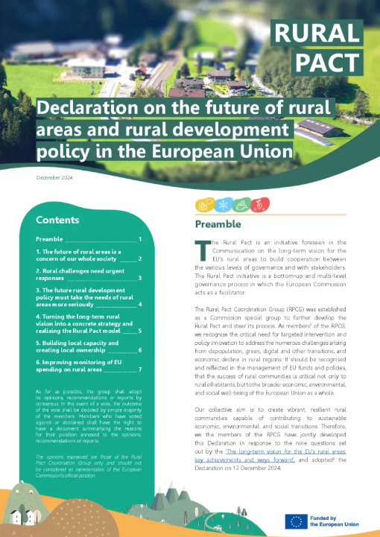
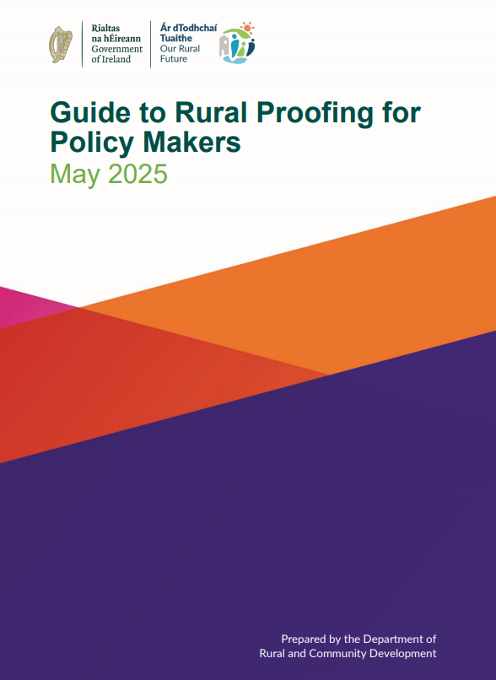
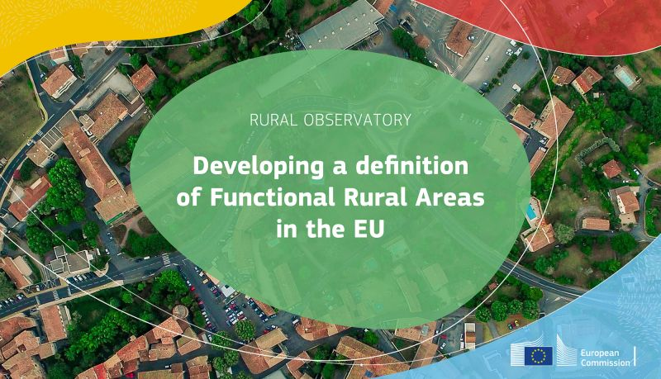
https://ruralpact.rural-vision.europa.eu/publications/rural-pact-coordination-group-rpcg-declaration-future-rural-areas-and-rural_en

Slide 27
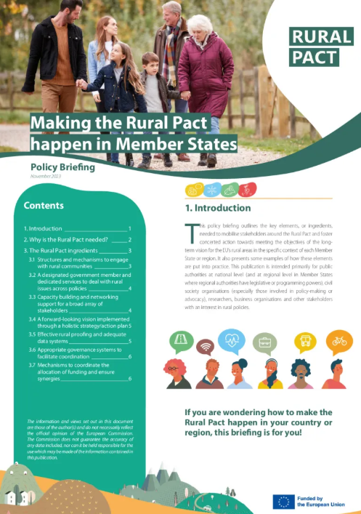
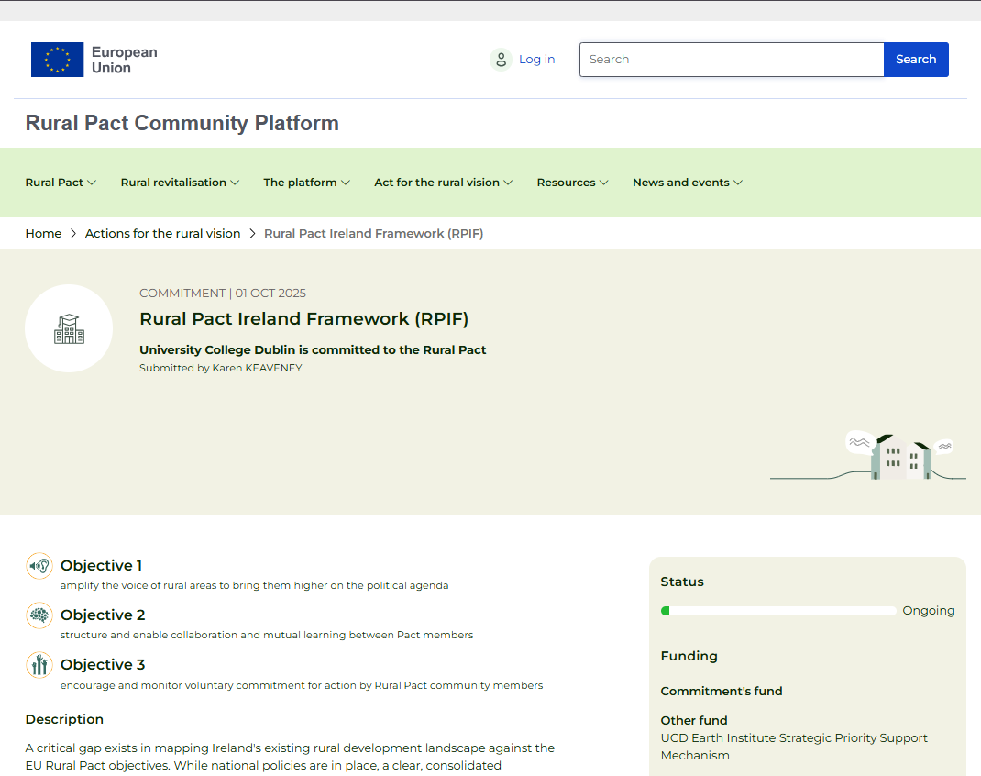
https://ruralpact.rural-vision.europa.eu/publications/making-rural-pact-happen-member-states_en
https://ruralpact.rural-vision.europa.eu/commitments/rural-pact-ireland-framework-rpif_en

Slide 28
Bridging the Gap: Local Rural Futures in the Context of National and European Strategies
Smart Towns & Villages Conference 2025 ‘Reimagining Rural Ireland’
Associate Professor Karen Keaveney
Citizen Rural Research Lab
UCD School of Agriculture & Food Science
Karen.Keaveney@ucd.ie
https://www.ucd.ie/citizenrural/
Photo: KKeaveney, Portrunny, Roscommon, IRL

Slide 29




Interinstitutional dialogue
European Parliament, Committee of the Regions and Economic and Social Committee
Opinion LTVRA (26 Jan 2022)
Opinion Smart Rural Europe (15 Mar 2023)
Opinion LEADER/CLLD and LTVRA (18 Feb 2025)
Opinion LTVRA (23 Mar 2022)
Opinion Energy (13 Dec 2023)
Opinion Youth (14 Dec 2023)
Opinion LTVRA implementation (24 Apr 2024)
Opinion Circular economy (23 Oct 2024)
Opinion Post-2027 cohesion policy (27 Feb 2024)
Report (13 December 2022)
Notes:
The work on the rural vision and the Rural Pact are contributing to bring issues higher on the political agenda including through dialogue between various European institutions and bodies.
The Committee of the Regions (CoR), the European Economic and Social Committee (EESC) and the European Parliament all adopted opinions in 2022, following the Commission Communication in 2021.
Other relevant opinions on the EU rural vision or specific sub-topics have been issued since.

