Slide 1

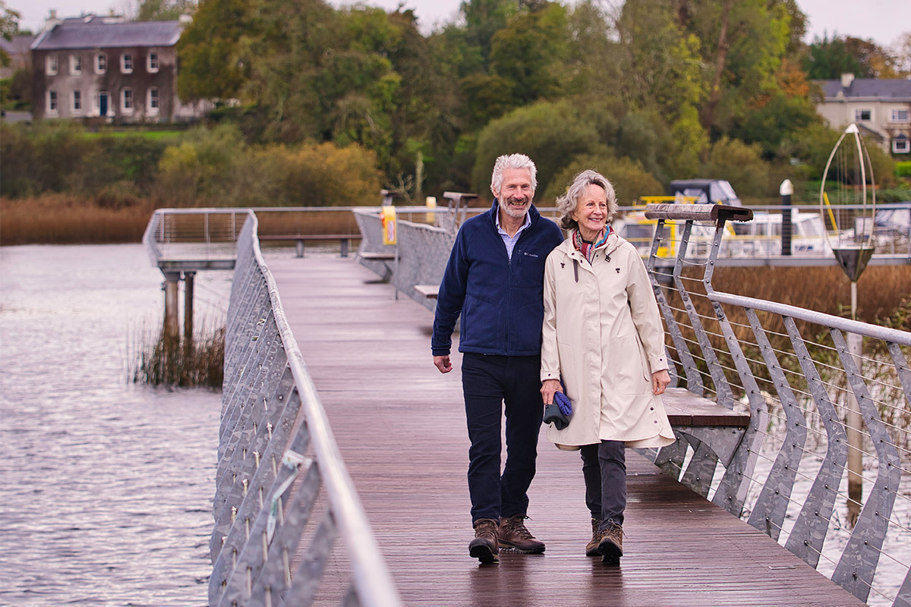
Local Economic and Community Plan
Implementation Plan 2026–2027
Date: 12 June 2026
Venue: Áras an Chontae
www.leitrim.ie

Slide 2
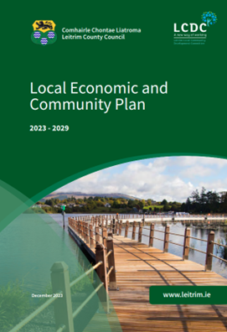
Local Economic and Community Plan (LECP) 2023 – 2029
The LECP is the Local Authority’s strategic framework for supporting economic and community development.
It translates national and regional policy into local actions that promote sustainable growth and enhance community well‑being.
The plan spans 2023–2029 and is delivered in three two‑year implementation phases.
Phase 1 (2023–2025) is now complete, and the 2026–2027 Implementation Plan has commenced.
This phased approach ensures the LECP remains responsive to emerging needs and evolving priorities.

Slide 3
Local Economic and Community Plan (LECP) 2023 – 2029
Key Aspects of the LECP
Purpose:
Sets clear objectives and actions for economic and community development, including infrastructure, employment, and quality of life improvements.
Inclusivity:
Developed with strong community input to ensure actions reflect local needs and aspirations.
Monitoring & Evaluation:
Implementation overseen by the LCDC using KPIs to ensure the plan remains dynamic, accountable, and responsive to evolving conditions.

Slide 4
Methodology for Implementation Plan Review
Community Feedback
A short public survey was circulated through the PPN, Older People’s Council, Comhairle na nÓg, and the Council’s social media channels.
  Survey aimed to capture community views on local needs, service gaps, and emerging challenges.
  Respondents provided information on their area, group involvement, familiarity with the LECP, and participation in LECP actions.
  Feedback covered priority needs, underserved groups, required supports/services, and accessibility of existing services.
  Participants also rated progress under the six LECP High‑Level Goals.
  Input gathered ensured a wide range of community perspectives informed the review and highlighted new or evolving needs for the updated implementation plan.

Slide 5

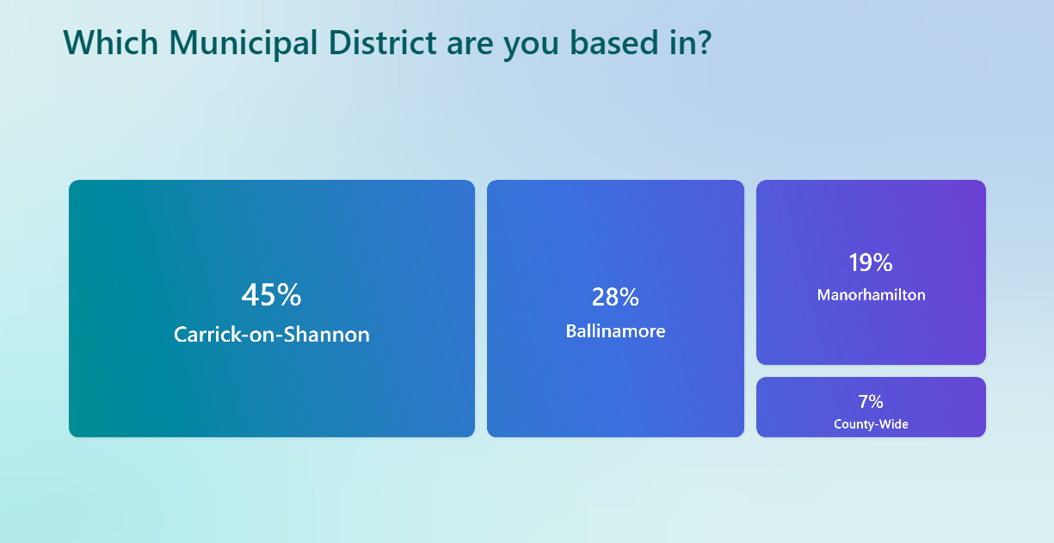
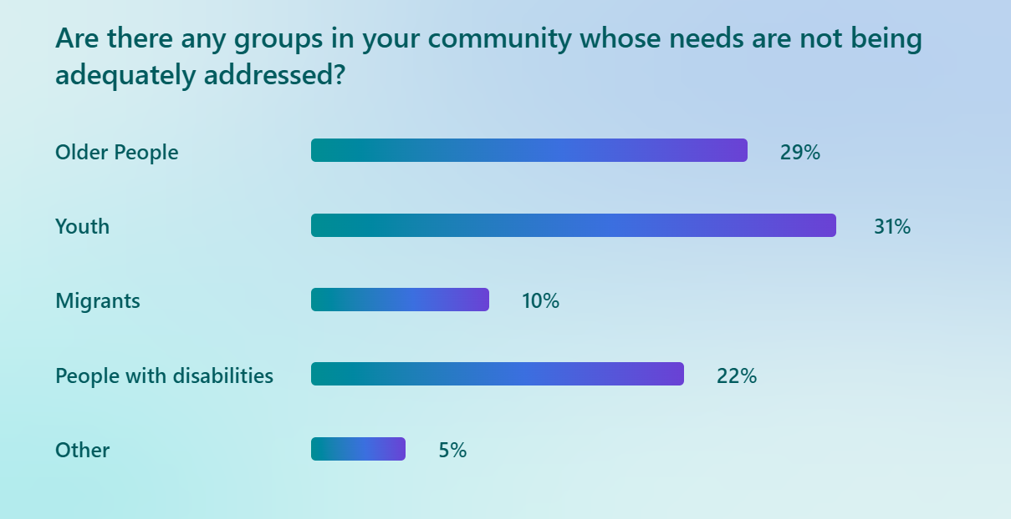
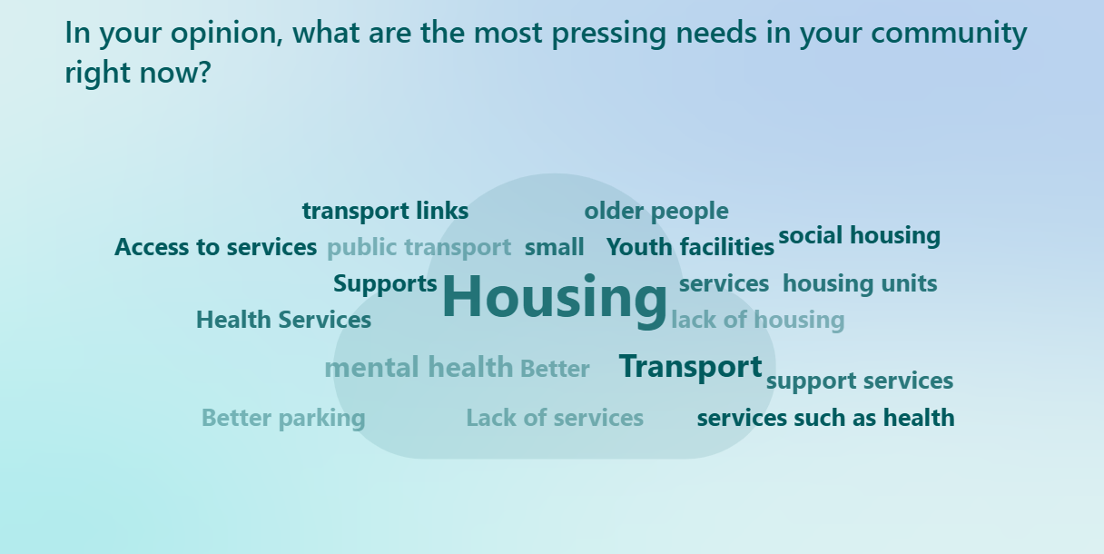
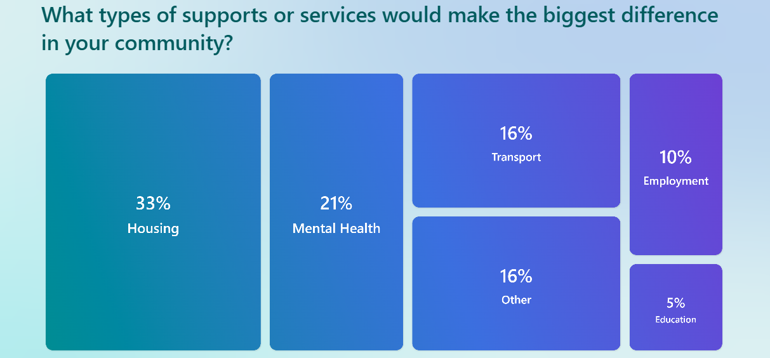
Community Feedback

Slide 6

Community Feedback – Supports And Services Needed
Housing: (Goal 3)
Strong demand for more affordable and appropriate housing, including social housing, smaller units, options for older people and young adults, tackling dereliction, and enabling rural housing delivery.
Transport & Connectivity: (Goal 1)
Need for more frequent, reliable and accessible public transport, improved Local Link and feeder services, better bus routes and schedules, and stronger connections to key towns and services.
Mental Health & Wellbeing: (Goal 1)
Calls for quicker access to mental health supports, early intervention for young people, local and out‑of‑hours services, and community‑based wellbeing and addiction supports.
Childcare & Family Supports: (Goal 1)
Need for additional childcare facilities, adequate homecare provision, and better family support services.
Employment, Skills & Economy: (Goal 5)
Demand for local employment opportunities, upskilling and training, business supports, and improved access to work and education.
Community, Social & Youth Infrastructure: (Goal 1)
Need for more social and meeting spaces, youth services, sports and wellbeing facilities, and central community support hubs to reduce isolation.
Environment, Place & Public Realm: (Goal 2 & 6)
Support for environmental initiatives, community amenities, improved traffic management, and greater consultation on town planning.
Tourism & Regional Development: (Goal 6)
Opportunities to better coordinate tourism assets across the wider region, supported by appropriate transport and infrastructure.
Concerns about town centres becoming overly alcohol‑focused.
Climate Action & Environmental Resilience (Goal 2)
  Local climate action workshops and practical guidance for communities.

Slide 7
Community Feedback – Recommendations
Housing & Dereliction (Goal 3)
  Need for dedicated housing resources to support delivery and tenant engagement.
Community Infrastructure, Inclusion & Social Connection (Goal 1)
  Need for supports specifically for bereavement, community safety and drug‑related issues.
  Strong emphasis on integration and disability inclusion in service delivery.
Youth, Children & Families (Goal 1)
  Structured activities required aimed at preventing antisocial behaviour.
  Mental health supports required specifically targeted at children and young people.
Economy, Employment & Business Supports (Goal 5)
  Need for clearer, more regular communication on business grants, supports and business networking opportunities.
Tourism, Place & Quality of Life (Goal 6)
  Calls to reopen local amenities and hotels for community use.
Governance, Awareness & Delivery of the LECP
  Need for better public awareness of the LECP outside Local Authority and PPN structures.

Slide 8
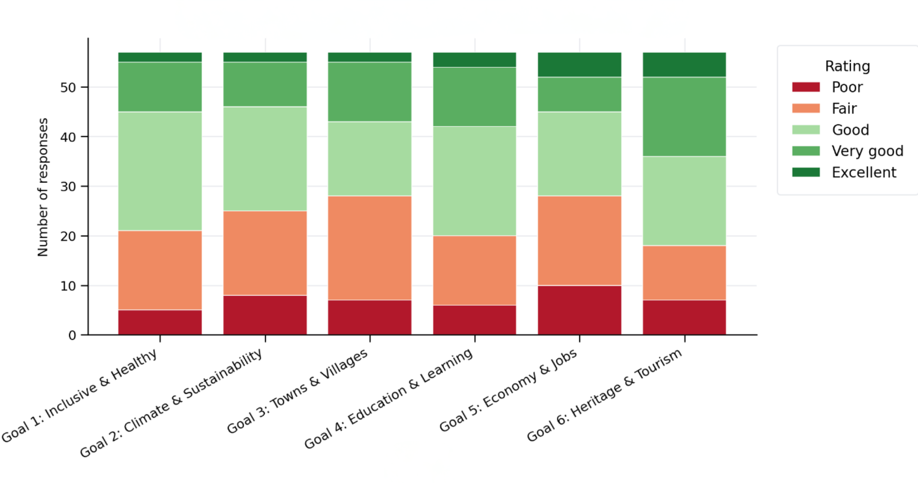

Community Feedback
Rate how well Leitrim is doing in each of its' six LECP goals.

Slide 9
Progress Reporting and Implementation Plan Review
Progress reports against the action plan are presented to the LCDC twice annually.
An internal review to amend the LECP was undertaken by the LCDC and relevant Leitrim County Council departments, including Planning, Local Enterprise Office (LEO), Community, Sports Partnership, Town Teams, Environment, Roads, Economic Development, Tourism and Arts.
External agencies were surveyed to gather feedback on the Implementation Plan, including Leitrim Development Company, Coillte, Teagasc, Volunteer Centre, Waterways Ireland, Leitrim Childcare Committee, DVAS, HSE and NCYCS.
All actions were reviewed to ensure alignment with LECP strategic goals and implementation priorities, to identify achievements, gaps and emerging issues.
Operational processes, partnership arrangements, and resources were reviewed
to ensure effective and strategic implementation.

Slide 10

Gaps Identified
A key gap identified during the review relates to the inclusion of newly established sections within Leitrim County Council that were not in place during the initial preparation of the 2023–2029 LECP. These include:
  The Local Authority Integration Team (LAIT) – coordinates and supports the integration of migrants, refugees and new communities by linking local services, community groups and statutory agencies.
  The Local Community Safety Partnership (LCSP) - brings together residents, community organisations and statutory agencies to identify local safety concerns and coordinate actions to help people feel safe and be safe in their communities.
  Both sections have now been incorporated into the plan, with their responsibilities and activities reflected under Goal 1: Leitrim will continue to develop as an inclusive, healthy and equitable county that supports wellbeing and is celebrated as a great place to live.

Slide 11


Gaps Identified
  Development of a community garden network and annual community garden week promoting biodiversity awareness. This has been incorporated into the plan under Goal 2 Leitrim will embrace climate action to increase the sustainability of its communities and unlock the benefits of the green economy
  Develop and implement a Diaspora Strategy to enhance engagement, collaboration and investment opportunities with the Leitrim diaspora. This has been incorporated into the plan under Goal 6 Leitrim will champion its natural and cultural environment and support the development of the county as a tourism destination in a sustainable and balanced manner

Slide 12
Gaps Identified
Feedback from consultation highlighted childcare as a key priority. In response, a new action has been included to strengthen access to quality early childhood education and after-school provision, supporting family wellbeing and enabling participation in work, education and training. This has been incorporated into the plan under Goal 1: Leitrim will continue to develop as an inclusive, healthy and equitable county that supports wellbeing and is celebrated as a great place to live.
While enabling agencies are identified within the LECP, no single lead agency was assigned to individual actions. This has been amended to include designated lead agencies, thereby improving clarity around accountability and ownership during implementation.

Slide 13
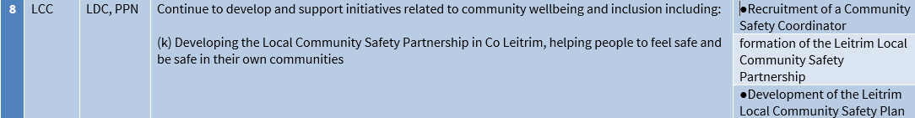
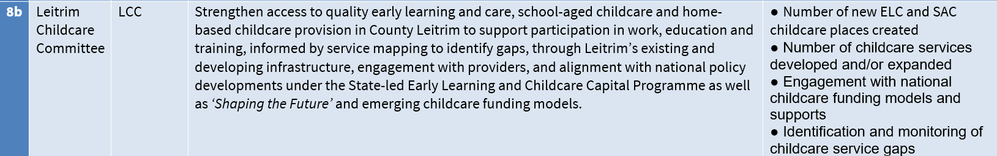
Actions and KPI’s added
Goal 1 Leitrim will continue to develop as an inclusive, healthy and equitable county that supports wellbeing and is celebrated as a great place to live
Goal 2 Leitrim will embrace climate action to increase the sustainability of its communities and unlock the benefits of the green economy
Goal 6 Leitrim will champion its natural and cultural environment and support the development of the county as a tourism destination in a sustainable and balanced manner

Slide 14
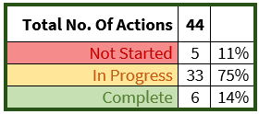
Reviewed Progress on Actions
Reviewed Progress on Actions
  Last year, a comprehensive review was undertaken to assess the status and overall progress of all actions within the LECP. This review examined each action individually to determine whether it was on track, completed, facing delays, or required reconsideration. A copy of the Progress Review 2025 is attached.
Following this review:
  All actions marked as “Complete” were revisited to confirm that they had been fully delivered.
  Actions identified as “Not Started” were reviewed in detail to determine whether they should be amended, rescheduled, or removed, where progress was no longer feasible due to changing circumstances, organisational priorities, or external factors.
  Actions marked as “In Progress” were reviewed to confirm that they remain on
  target and are progressing as planned.

Slide 15
Internal Review – “Complete” Actions
# | Lead Agency | Enabling Agencies | Action | KPIs
10 | LCC | LDC | To assist in driving climate action and sustainability in the County: (a) Appoint a Climate Action Officer in the Council and establish a Climate Action Committee to coordinate initiatives throughout the County and raise awareness of sustainability supports in the private sector and community (b) Develop a Climate Action Plan for the County outlining innovation initiatives to address climate change. (c) Commence the process of the development of a baseline emissions study to understand the current level of emissions in the County which will assist in identifying areas for action and in progressing towards becoming carbon neutral | Climate Action Officer appointed Climate Action Committee established Climate Action Plan developed Baseline of emissions study for the county progressed
28 | LEO | LCC | Maintain a clear investor/new business journey process and publish the mapped-out process on LEO/LCC website indicating the steps and associated forms required to setup a business in Leitrim and the indicative timelines involved in each step. | Investor/new business journey process published.
31 | LCC | LEO | Establish a county-wide mechanism to support economic development through greater collaboration with relevant stakeholders. | Mechanism established
35 | LCC |  | Develop a unified brand for the County that brings together the various existing strands such as Leitrim Business, Leitrim Tourism and Relocate to Leitrim to develop a more coordinated approach to the messaging and promotion of the County. | New unified brand created.
39 | LCC | Fáilte Ireland | Develop a new tourism strategy for Leitrim. | New Leitrim tourism strategy developed
43 | LCC | Tourism Providers | Look to increased coordination and capability across all those involved in the tourism sector in the County through working with Leitrim County Council and tourism providers in an effort to enhance co-ordination. | Tourism sector forum established Methodology to accurately capture tourism data in Leitrim developed.

Slide 16
Internal Review – “Not Started” Actions
# | Lead Agency | Enabling Agencies | Action | KPIs | Review
4 | Domestic Violence Advocacy Service (DVAS), | LCC | Support local and community initiatives to prevent and mitigate Domestic, Sexual and Gender Based Violence in accordance with the 3rd National Strategy on Domestic Sexual and Gender-Based Violence Implementation Plan. | No. of initiatives supported from the National Strategy on Domestic Sexual and Gender-Based Violence Implementation Plan. | Keep action: Updates on initiatives such as “Safe to Call” and “Power to Change” programmes have since been received. Ongoing collaboration with Sports Partnership and LCSP will improve feedback reporting.
16 | LEO | LCC, Town Teams, LDC | To drive footfall and assist in the regeneration of town centres, pilot an initiative for pop-up shops in vacant buildings with market traders encouraged to take over such buildings for a short period of time. | Pilot initiative implemented | Keep action: Procedures and lease templates developed. Barriers: Poor take-up from property owners, vacant property rates are not at a level such that offsetting them is a sufficient incentive.
17 | LCC | Town Teams, PPN, LSP | Conduct a mapping study of towns and villages in Leitrim to understand where gaps are in relation to amenities including community, sporting, cultural and recreation facilities and potential areas of decline, and to identify opportunities for regeneration that creates spaces that are safe and accessible for all the community. | Mapping study of towns and villages including community, sporting and recreational facilities completed | Keep action: Remove Leitrim Library as an enablers, and added Leitrim Sports Partnership.
21 | LCC | ATU | Enhance links with the ATU in Sligo and explore the feasibility of establishing an off-campus hub/landing space of the ATU in Leitrim. | Potential location identified and off campus hub concept considered | Keep action: No progress reported to date on identifying a location or developing the off-campus hub concept
40 | LCC | NPWS, NWRA | In line with the County Development Plan, conduct a feasibility study into whether North Leitrim could be designated a National Park/Recreational Area. | Feasibility Study completed | Keep action: Initial scoping discussions have begun.

Slide 17
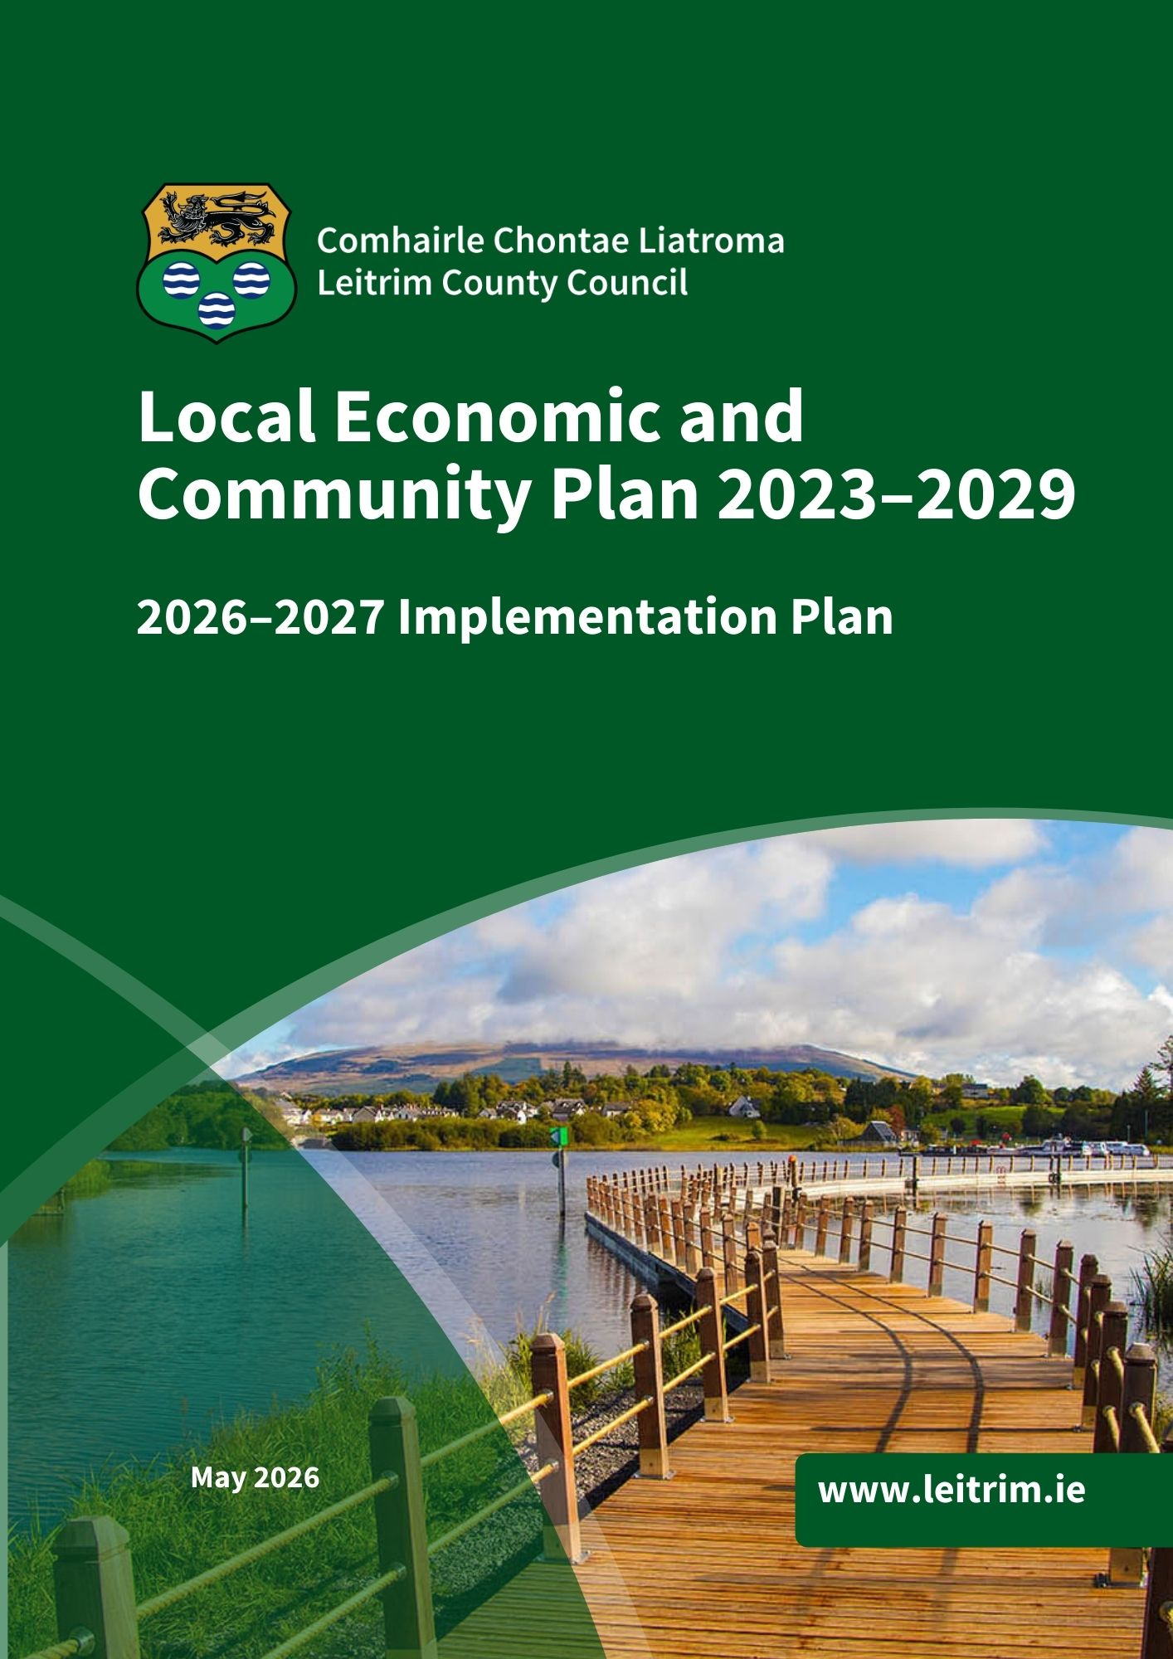
What’s Next for the LECP?
All actions reviewed and updated with new priorities and emerging needs included.
The two‑year Implementation Plan (2026–2027) is now ready.
Timeline for approvals:
SPC – (Social) | Wednesday 13th May
SPC – (Economic) | Friday 12th June
SEC | Monday 15th June
LCDC | Wednesday 17th June
Council Meeting | Monday 13th July

